Slide 1
Track Structural Analysis Rigid Frame
June 2021

Slide 2
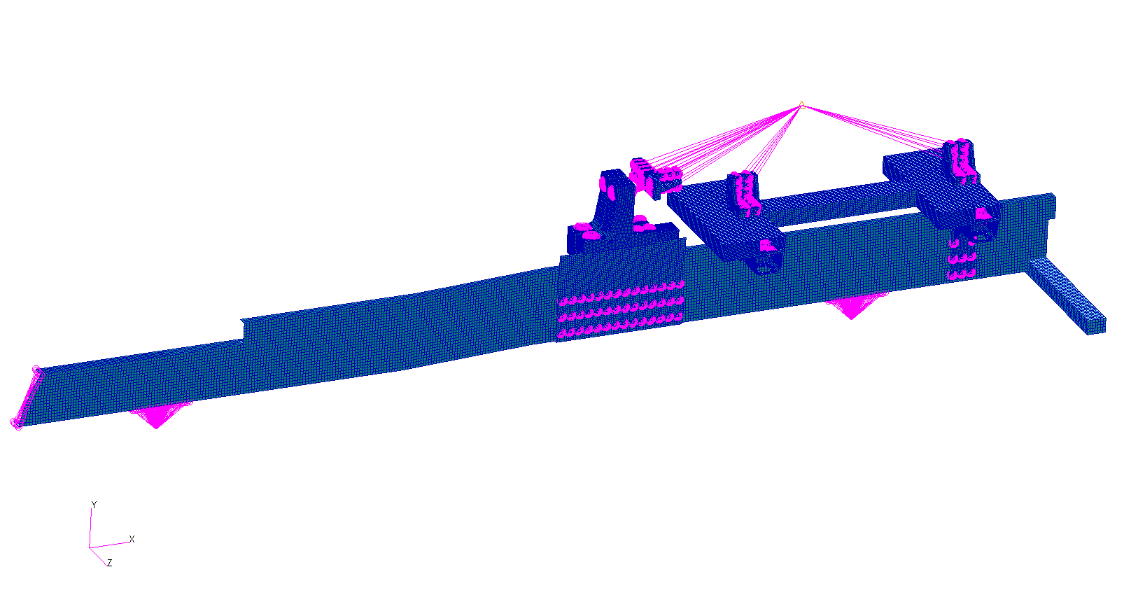
F.E model
Half model - Symmetry
Total mass (include box) = 2 [Ton] (Half model)

Slide 3
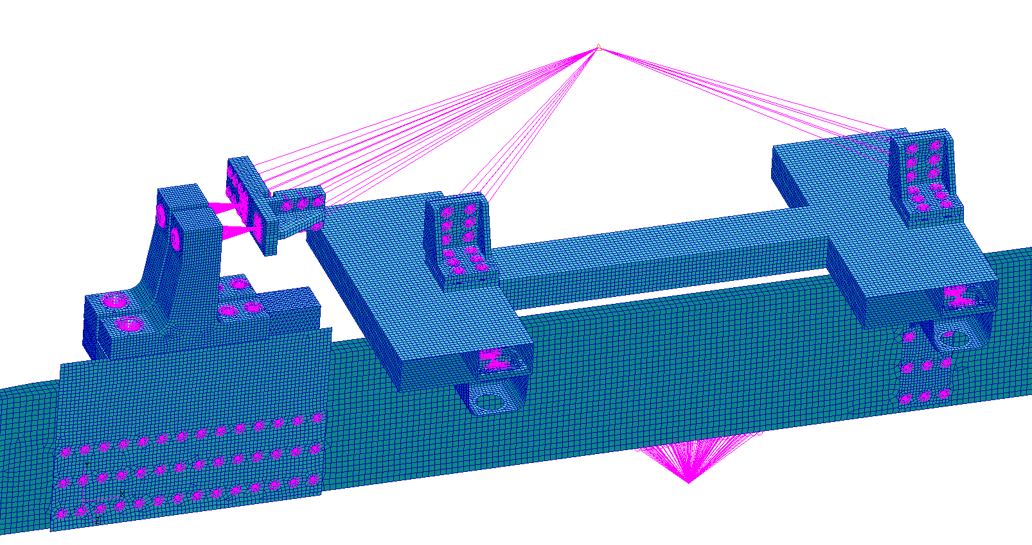
F.E model – Mass Distribution
Mass = 1.275[Ton] (Half model)

Slide 4
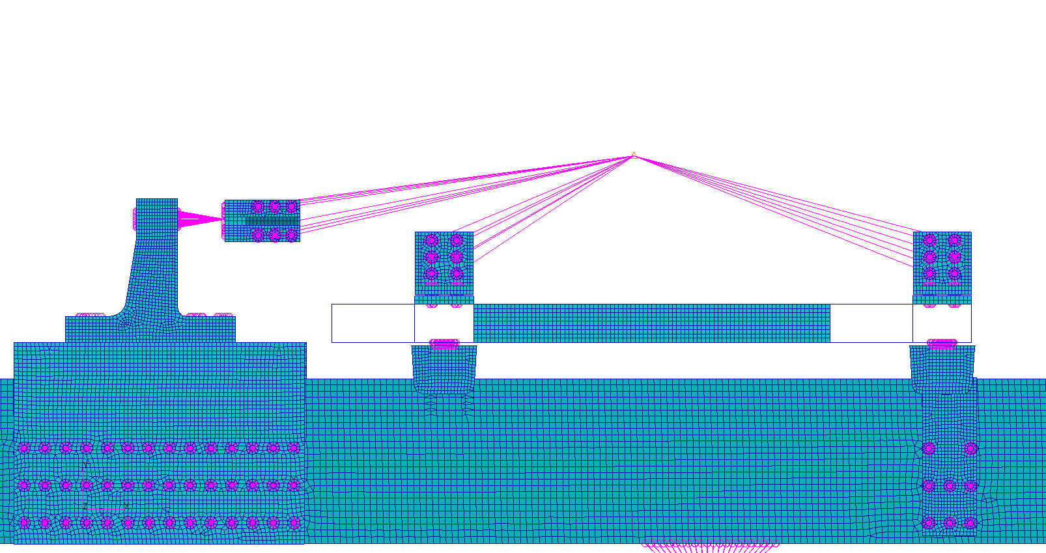
F.E model – Connections
Longitudinal connection (Only X direction)
Vertical connection (Only Y direction)

Slide 5
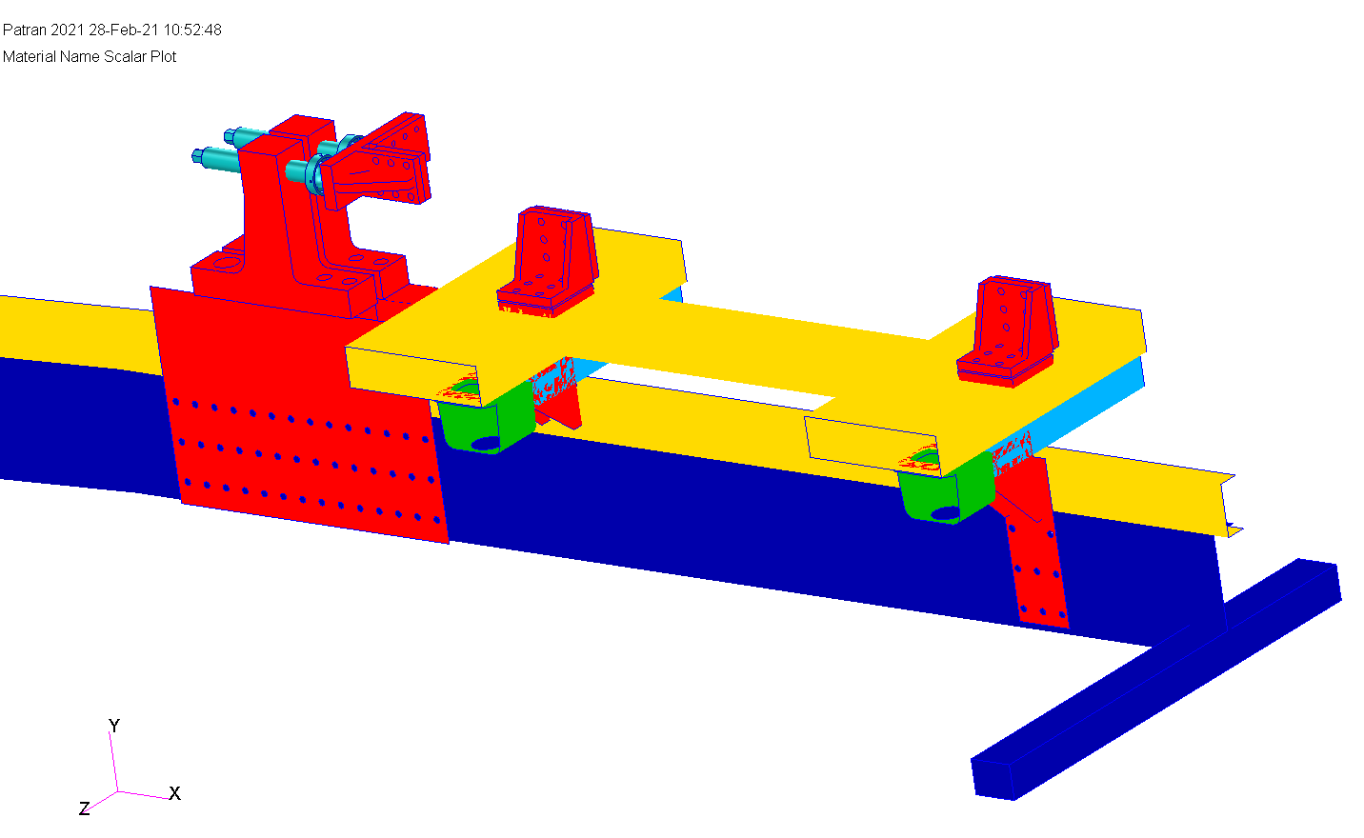
Material distribution
Red parts – Creusabro 4800
M45 Bolts – 4340
Yellow parts – ST52
Turquoise parts – ST37
Blue parts – Rigid
Green parts – casting Steel

Slide 6
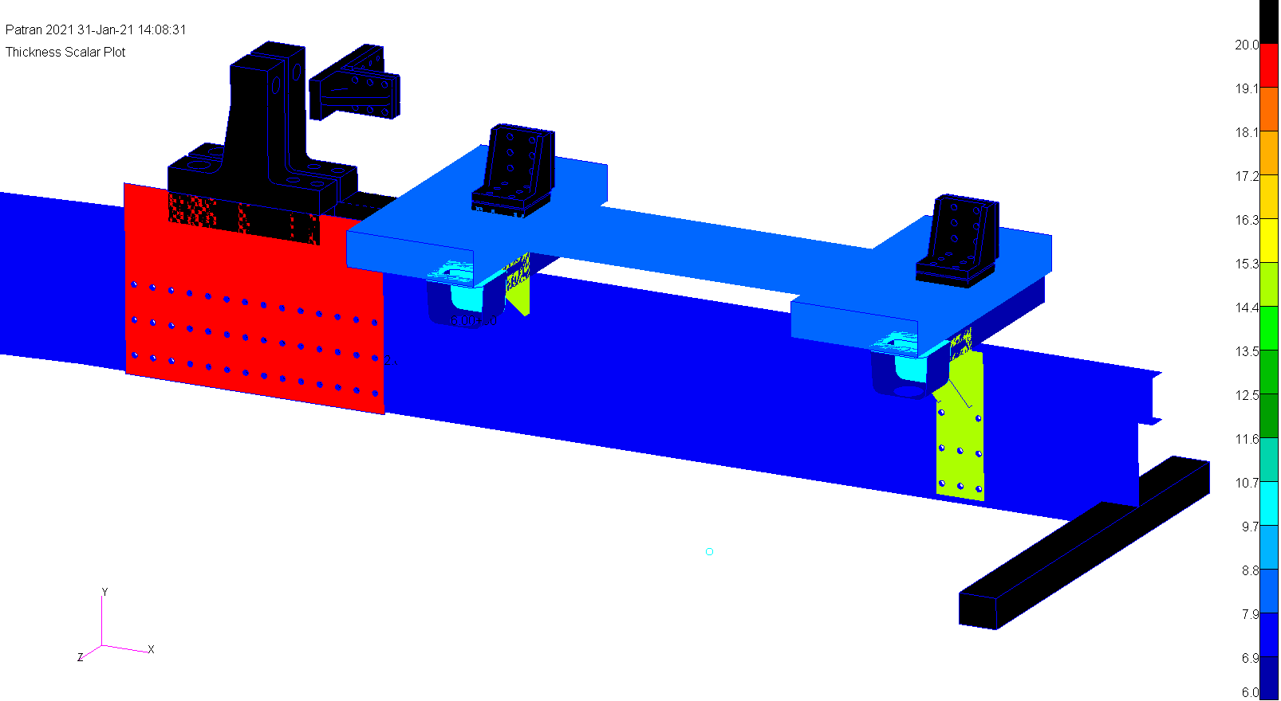
Thickness distribution [mm]

Slide 7
mechanical properties
Steel 4340 | Steel Casting | Steel ST37 | Steel ST52 | Steel Creusabro 4800
0.3 | 0.3 | 0.3 | 0.3 | 0.3 | $$v$$
7800 | 7800 | 7800 | 7800 | 7800 | $$ρ\left[{kg}/{m^{3}}\right]$$
21000 | 21000 | 21000 | 21000 | 21000 | $$E\left[{kg}/{{mm}^{2}}\right]$$
80 | 21 | 25 | 35 | 90 | $$σ_{y}\left[{kg}/{{mm}^{2}}\right]$$
94 | 42 | 37 | 52 | 120 | $$σ_{uts}\left[{kg}/{{mm}^{2}}\right]$$
18 | 20 | 25 | 15 | 12 | $$ε\left[\%\right]$$

Slide 8
Load Cases
Nonlinear analysis
Longitude (X axis) : -60g acting on all parts
60g

Slide 9
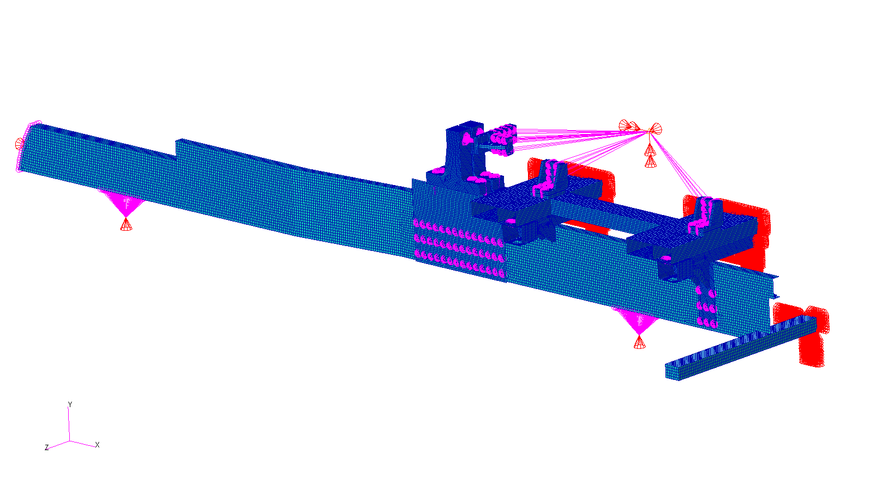
Boundary conditions
Front area fix in longitude X direction
Symmetry B.C (Half Model)
Wheels area fix in vertical Y direction

Slide 10
Nonlinear Static acceleration

Slide 11
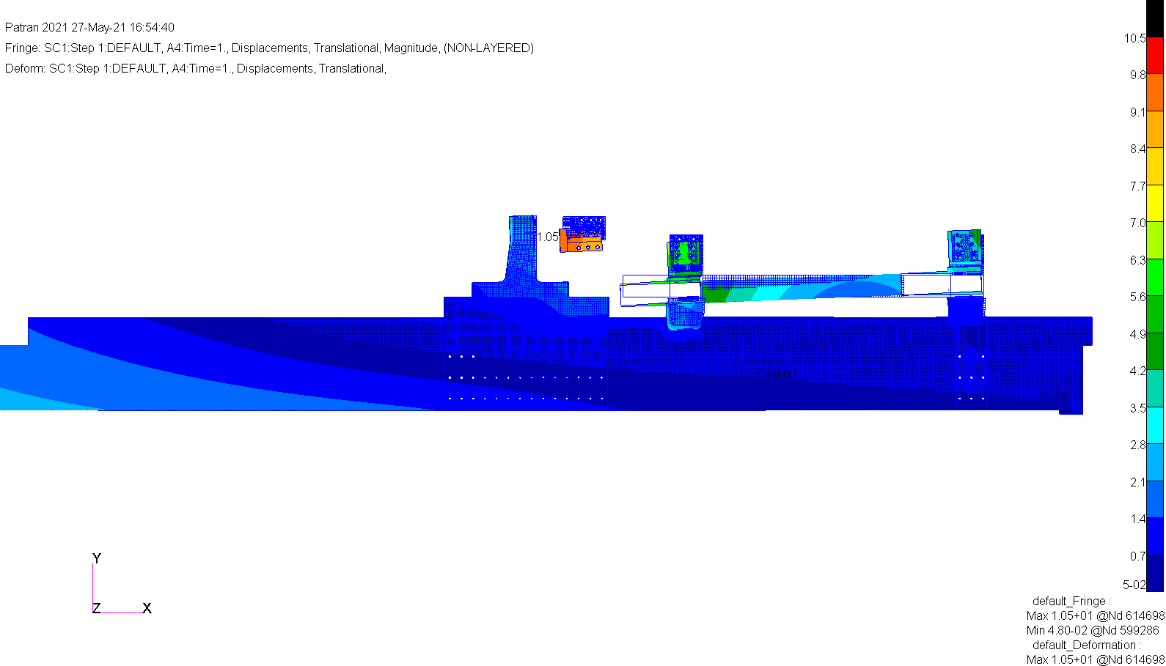
60g Longitude -X
Displacement magnitude [mm]

Slide 12
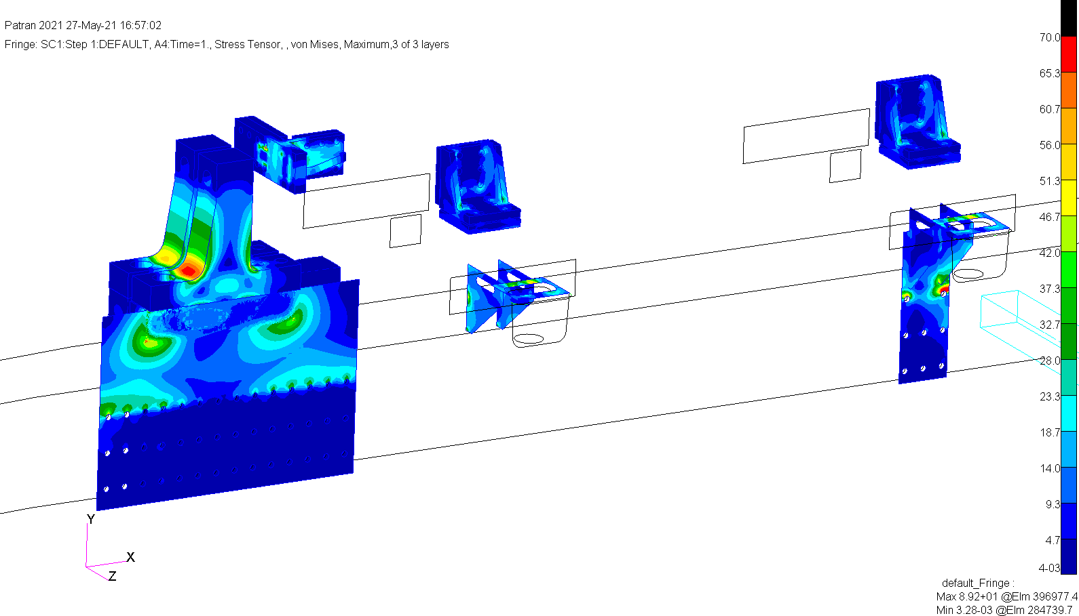
60g Longitude -X
Von Misses Stress [kg/mm²]
Creusabro 4800 Parts
Singular point
The actual Max stress is 70.0

Slide 13
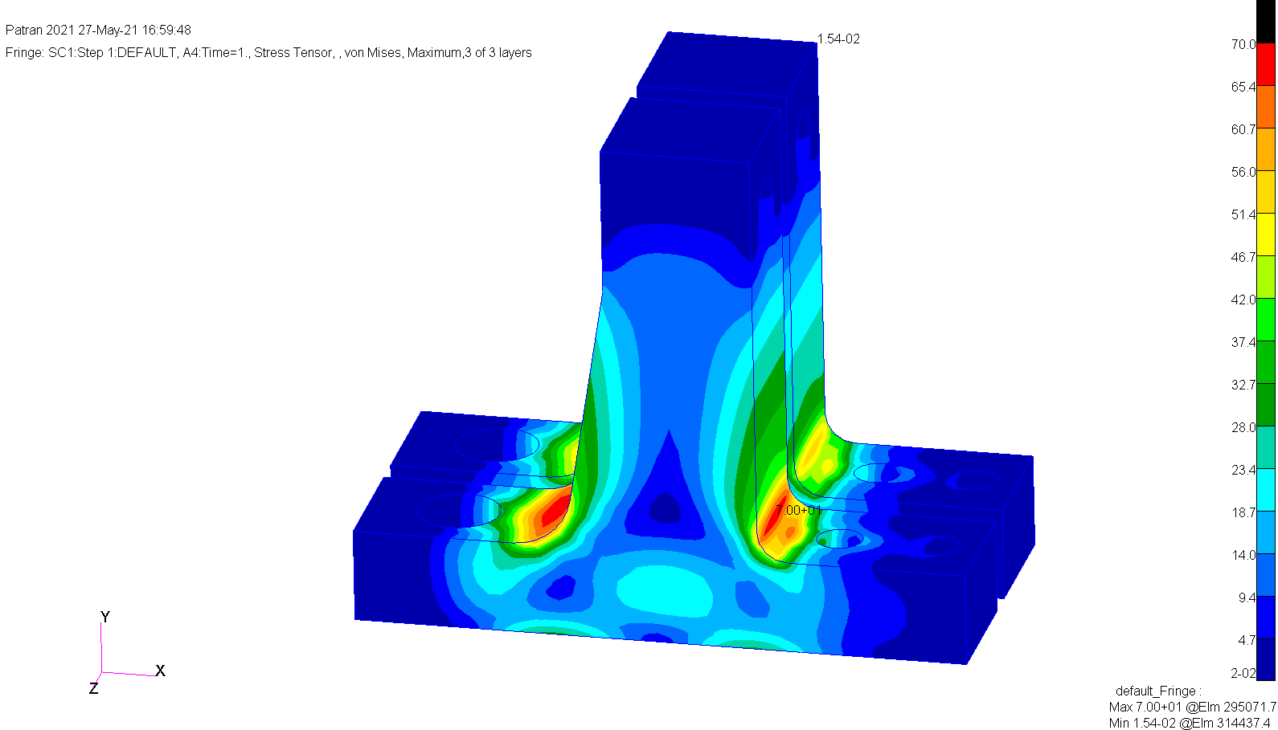
60g Longitude -X
Von Misses Stress [kg/mm²]
Creusabro 4800 Parts

Slide 14
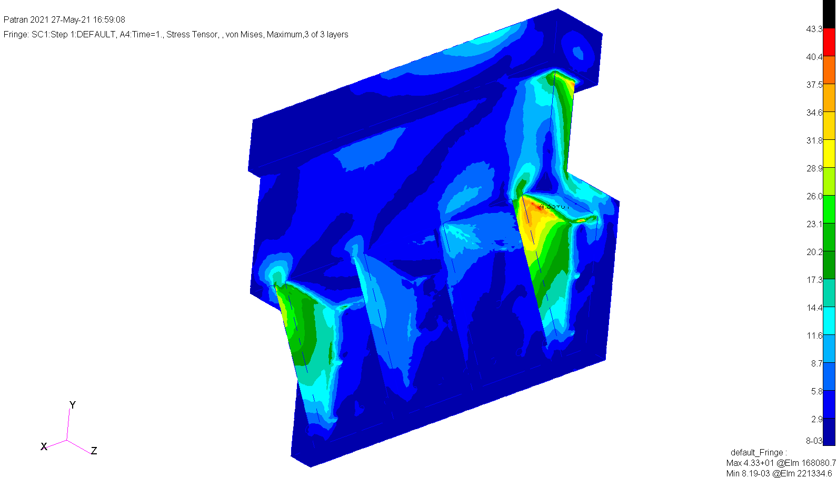
60g Longitude -X
Von Misses Stress [kg/mm²]
Creusabro 4800 Parts

Slide 15
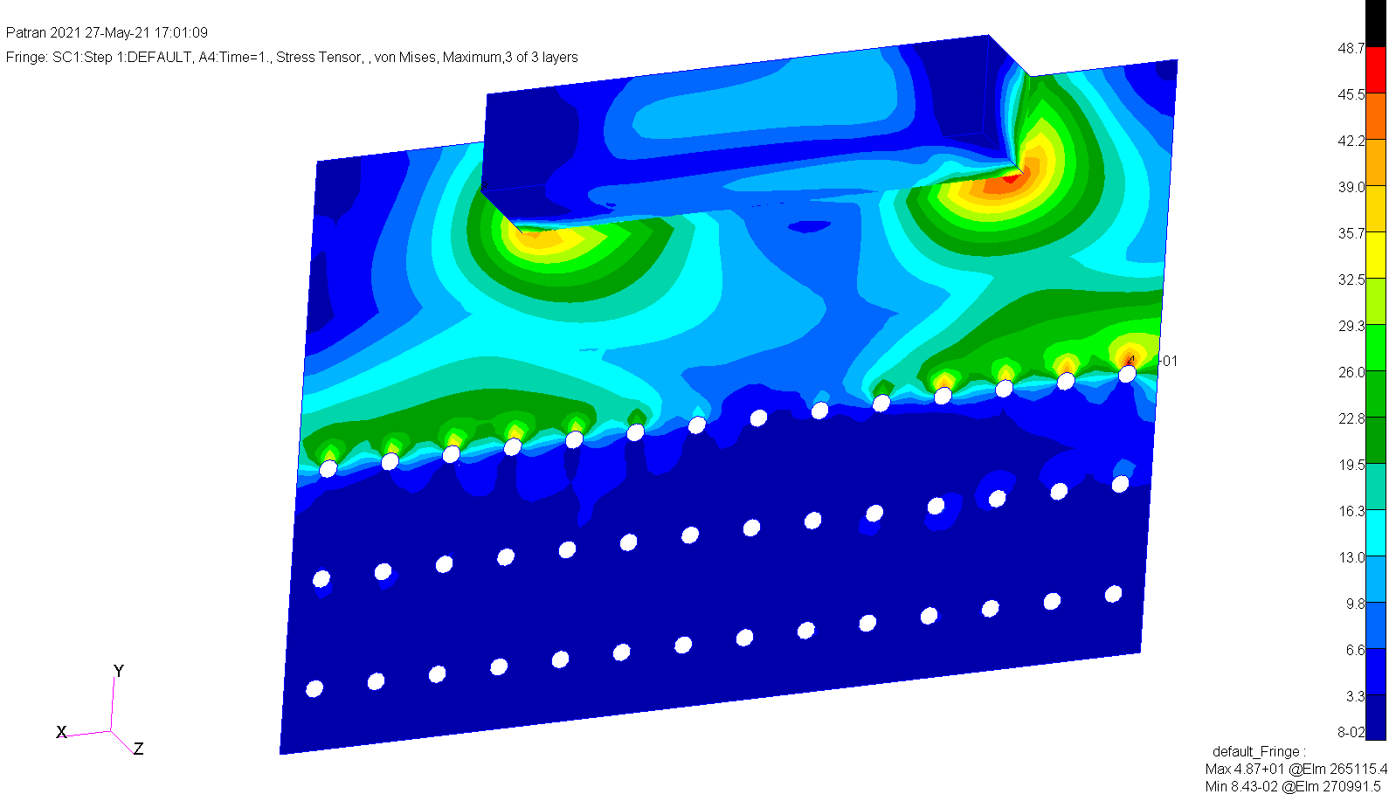
60g Longitude -X
Von Misses Stress [kg/mm²]
Creusabro 4800 Parts

Slide 16
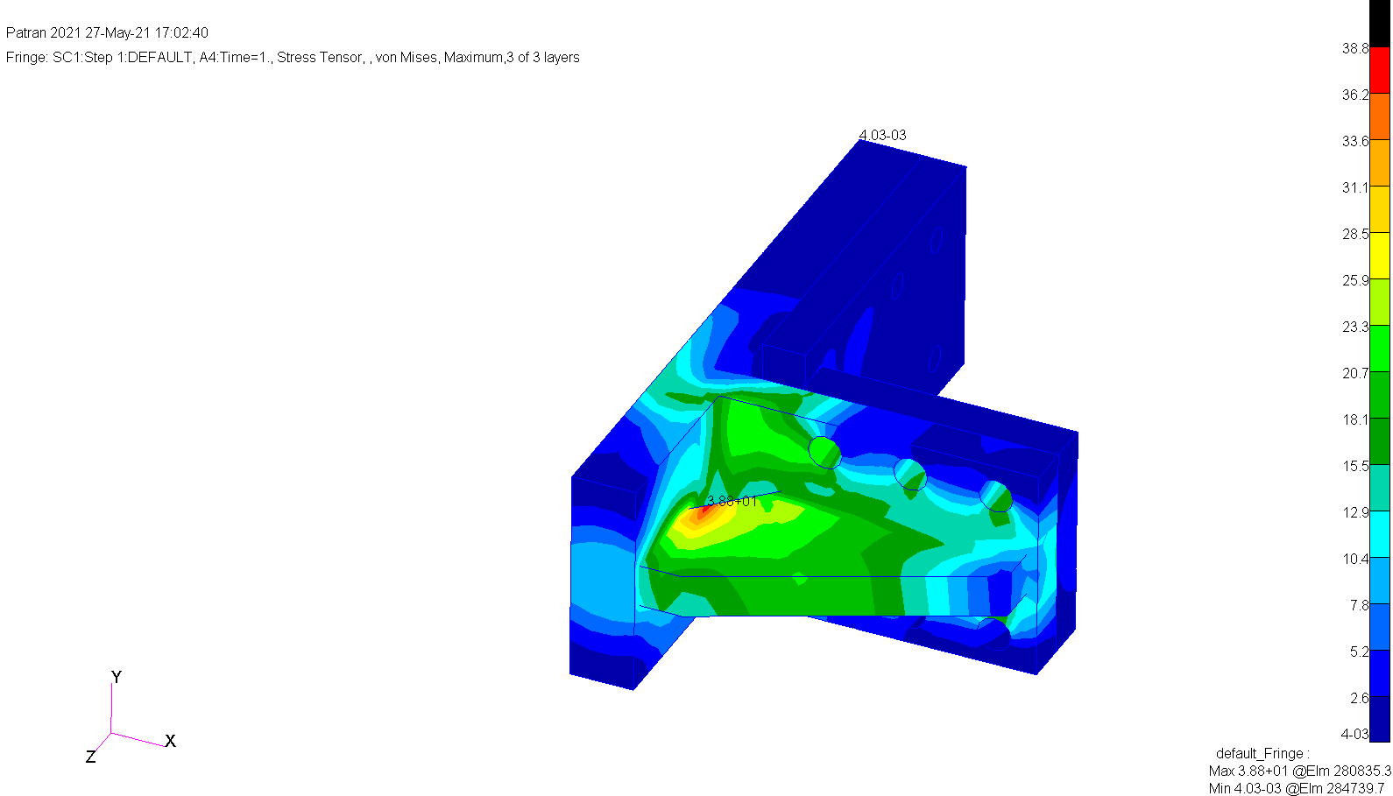
60g Longitude -X
Von Misses Stress [kg/mm²]
Creusabro 4800 Parts

Slide 17
60g Longitude -X
Von Misses Stress [kg/mm²]
Creusabro 4800 Parts

Slide 18
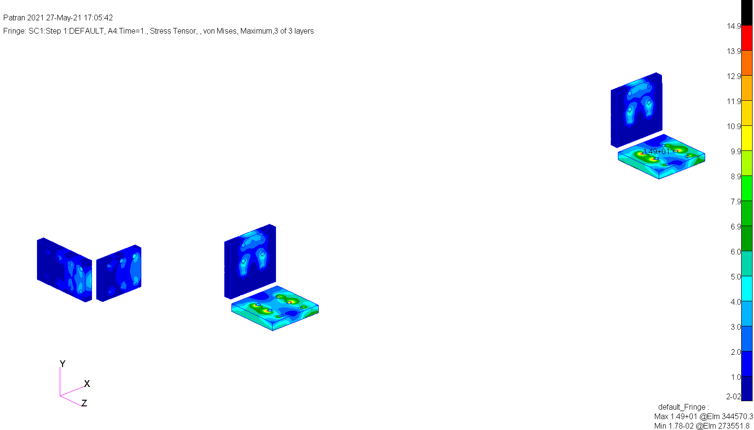
60g Longitude -X
Von Misses Stress [kg/mm²]
Creusabro 4800 Parts

Slide 19
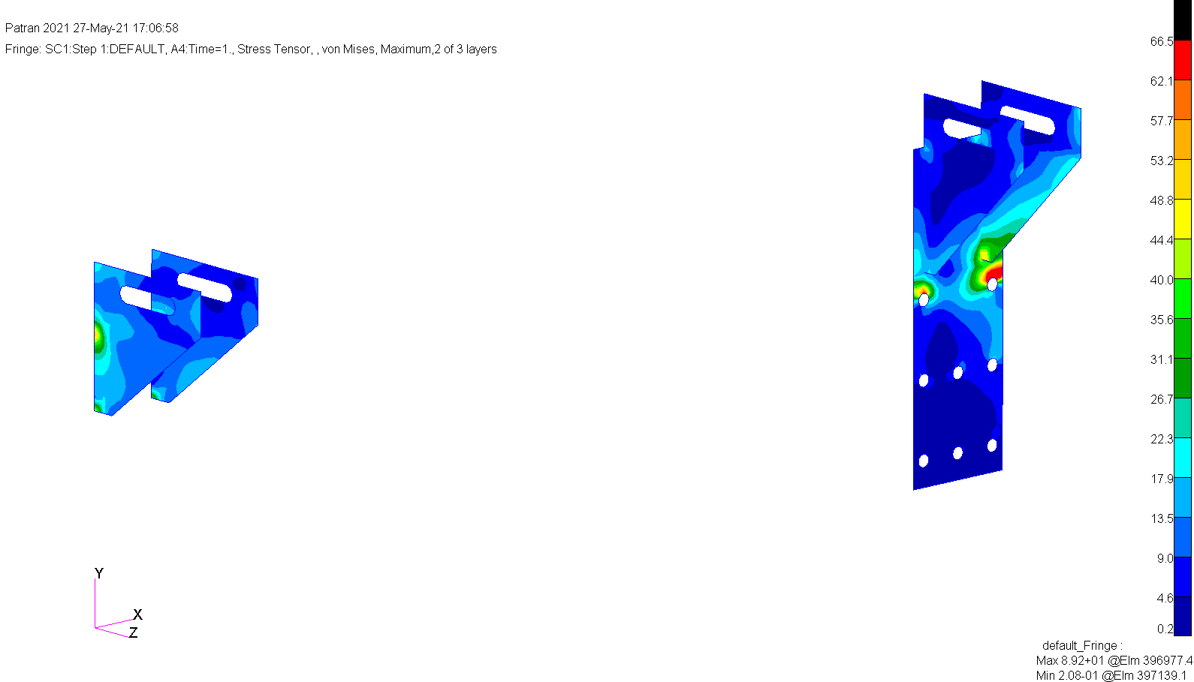
60g Longitude -X
Von Misses Stress [kg/mm²]
Creusabro 4800 Parts
Singular point
The actual Max stress is 66.5

Slide 20
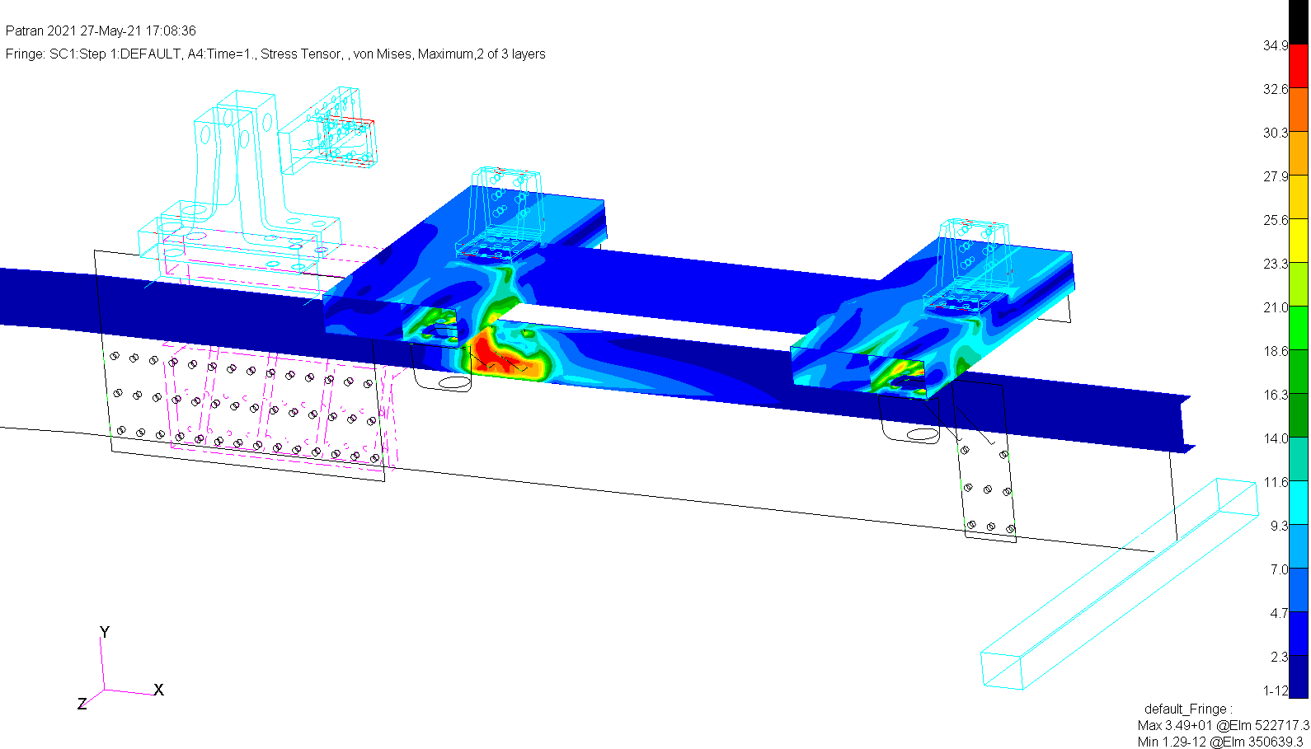
60g Longitude -X
Von Misses Stress [kg/mm²]
ST52 Parts

Slide 21
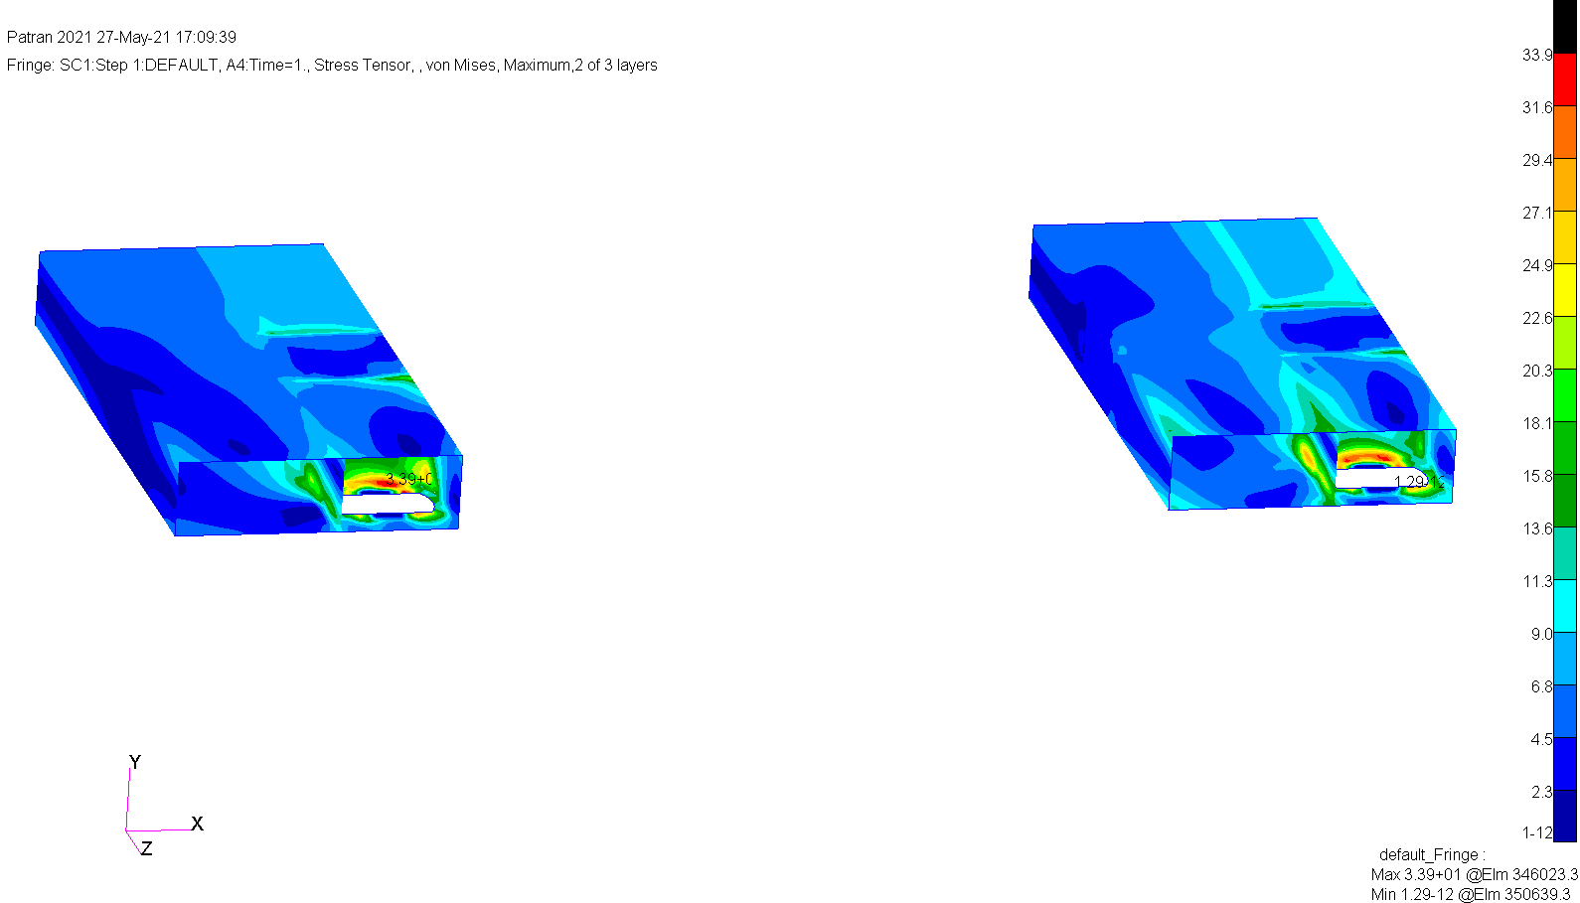
60g Longitude -X
Von Misses Stress [kg/mm²]
ST52 Parts

Slide 22
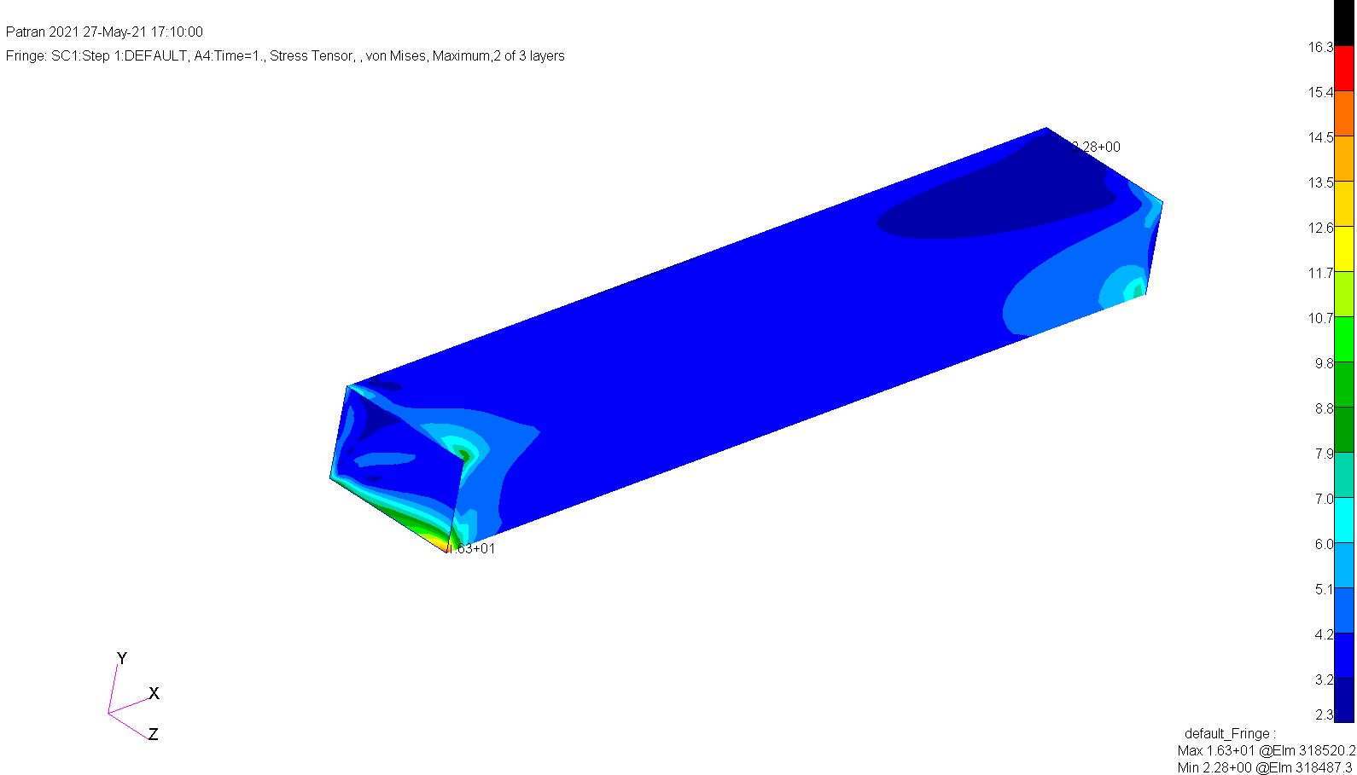
60g Longitude -X
Von Misses Stress [kg/mm²]
ST52 Parts

Slide 23
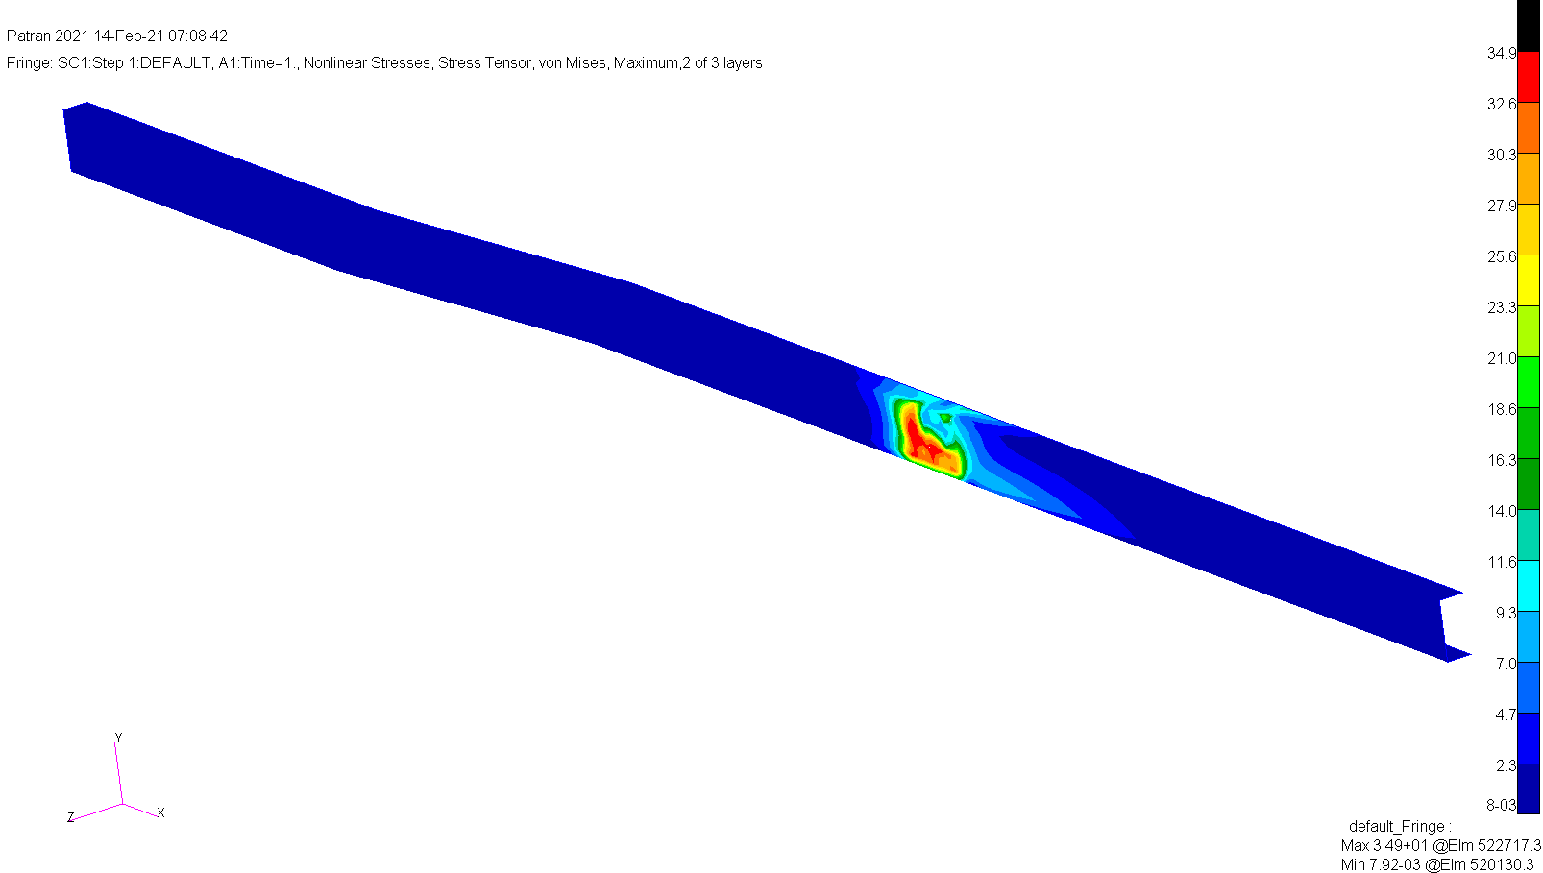
60g Longitude -X
Von Misses Stress [kg/mm²]
ST52 Parts

Slide 24
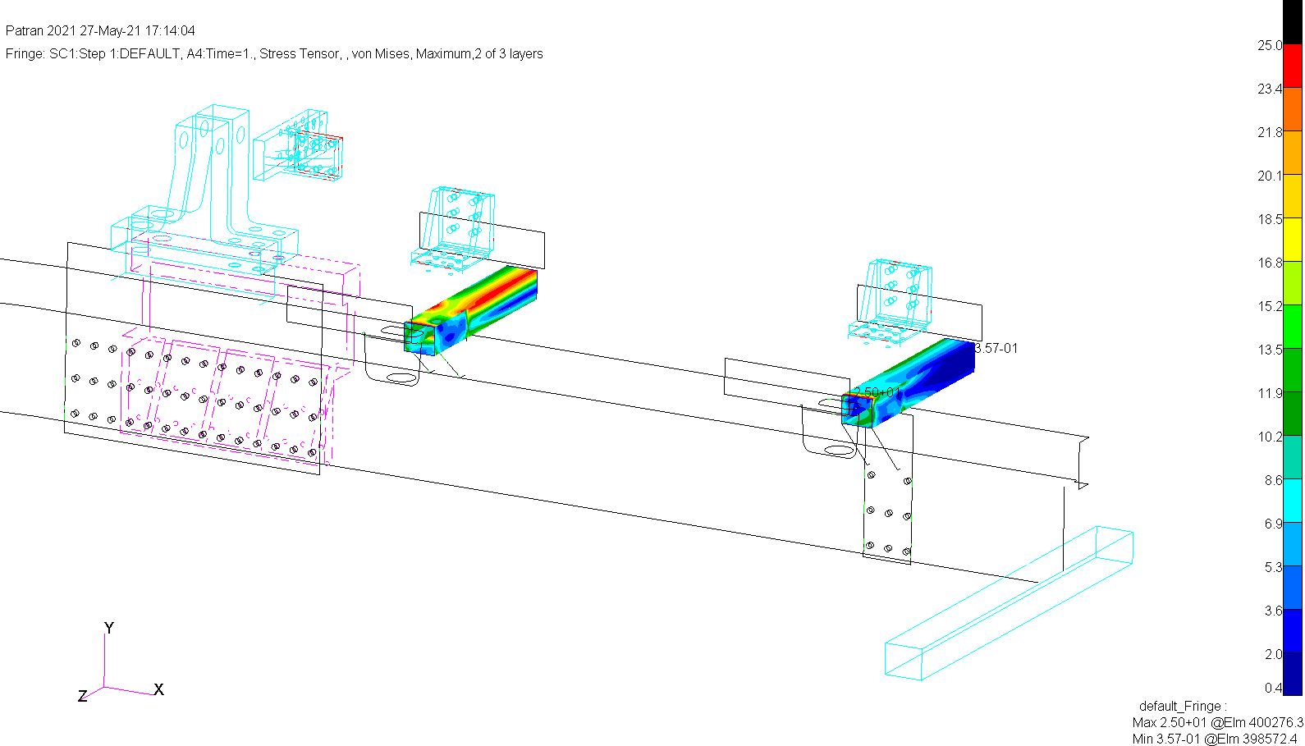
60g Longitude -X
Von Misses Stress [kg/mm²]
ST37 Parts

Slide 25
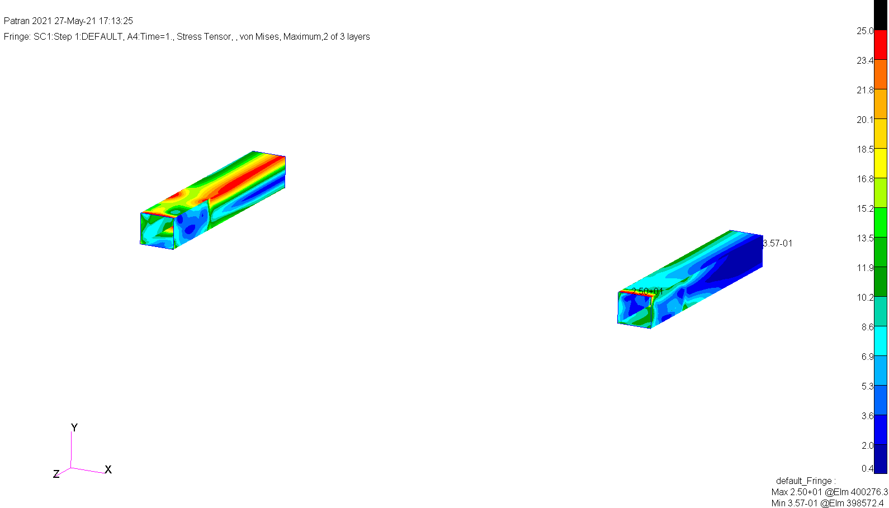
60g Longitude -X
Von Misses Stress [kg/mm²]
ST37 Parts

Slide 26
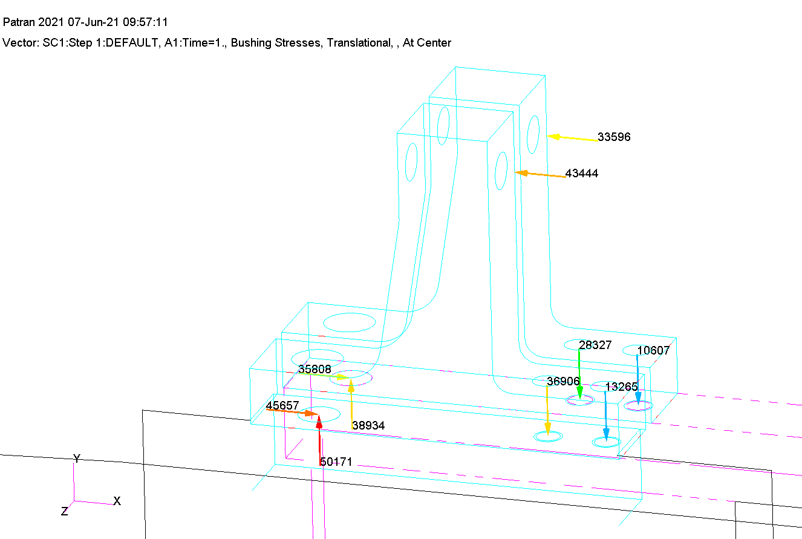
60g Longitude -X
Bolt Forces [Kg]

Slide 27
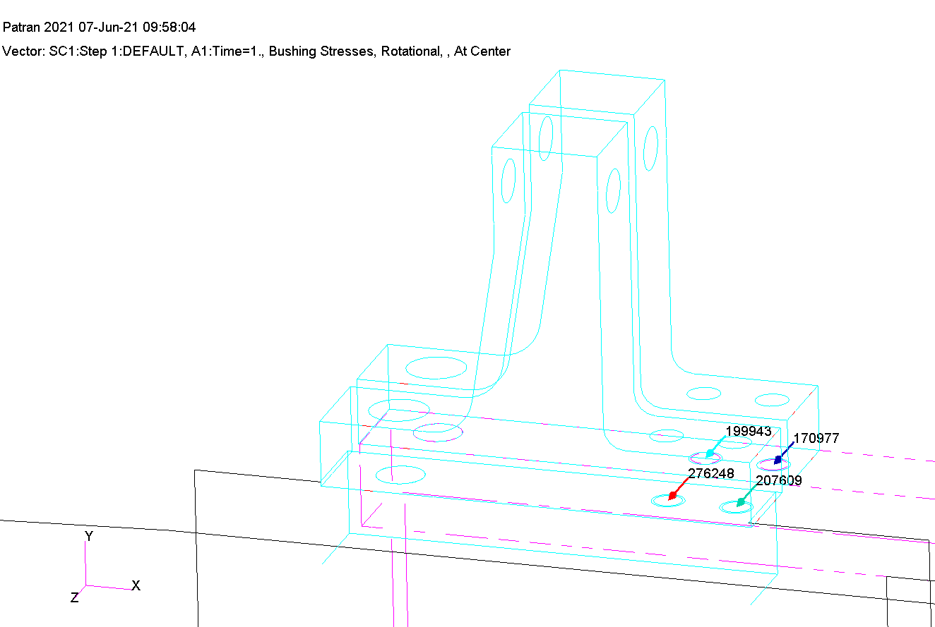
60g Longitude -X
Bolt Moments [Kg*mm]

Slide 28
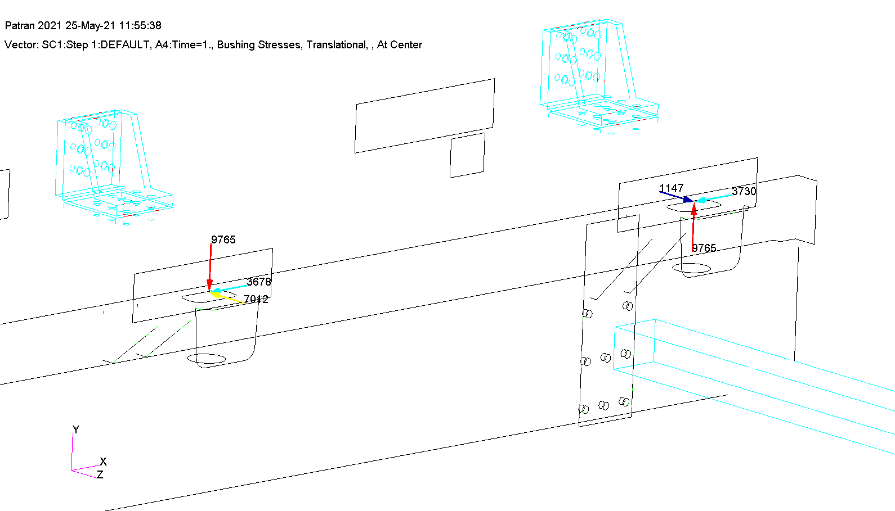
60g Longitude -X
TL Forces [Kg]

Slide 29
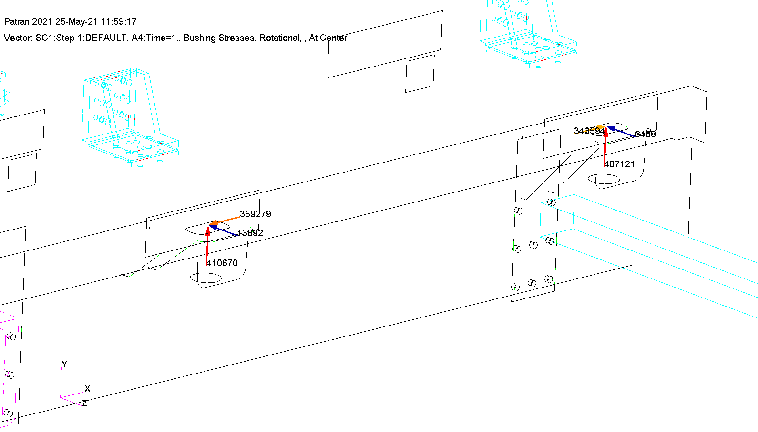
60g Longitude -X
TL Moments [Kg*mm]

Slide 30
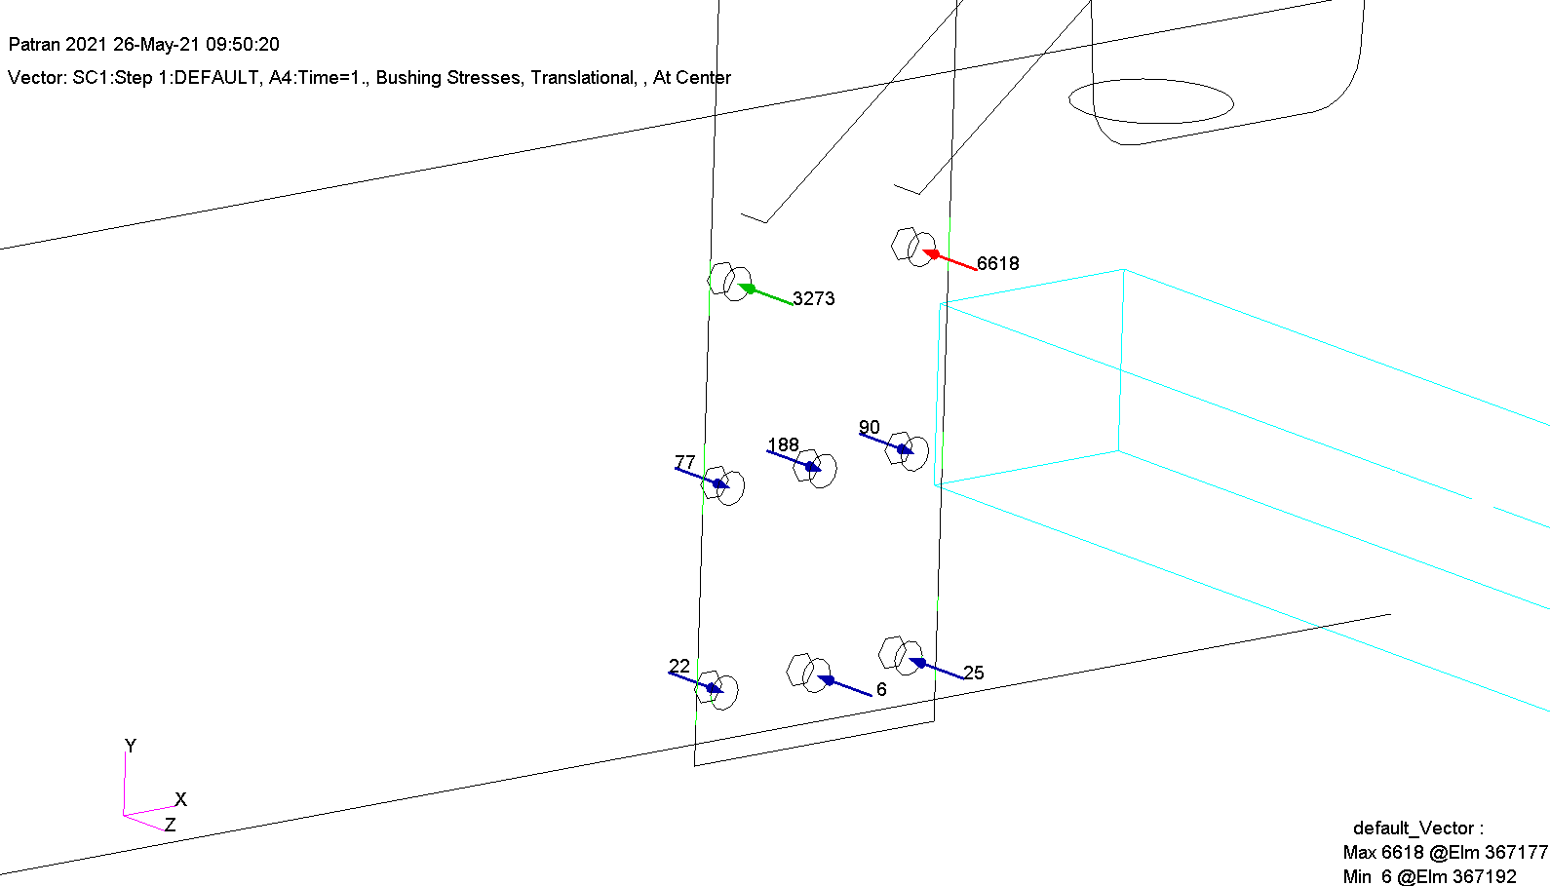
60g Longitude -X
Bolt axial Forces [Kg]

Slide 31
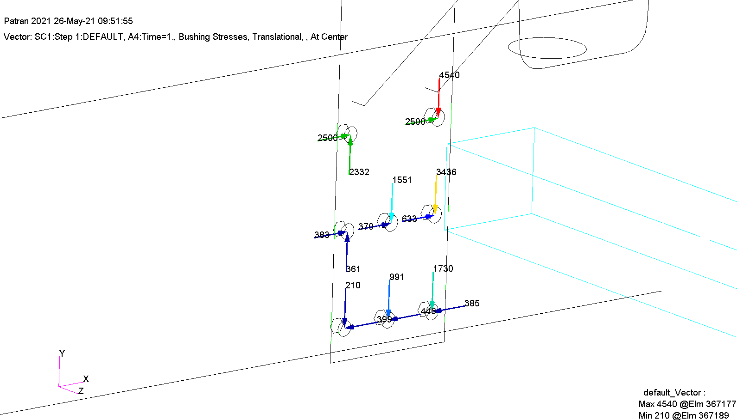
60g Longitude -X
Bolt friction Forces [Kg]

Slide 32
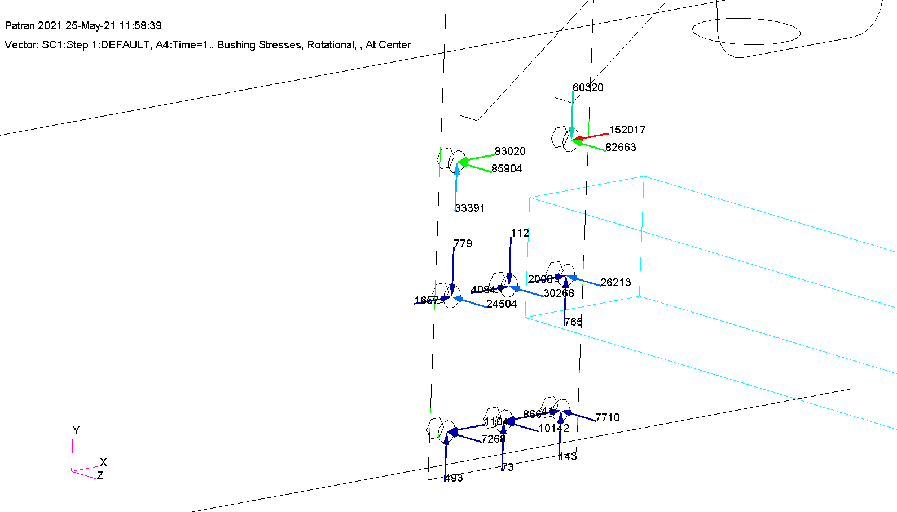
60g Longitude -X
Bolt Moments [Kg*mm]

Slide 33
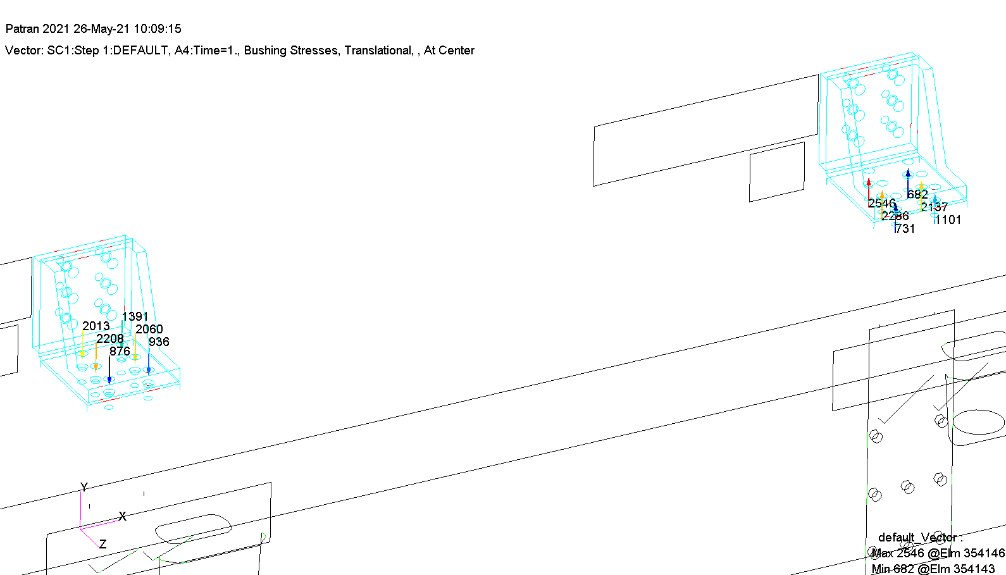
60g Longitude -X
Bolt Forces [Kg]

Slide 34
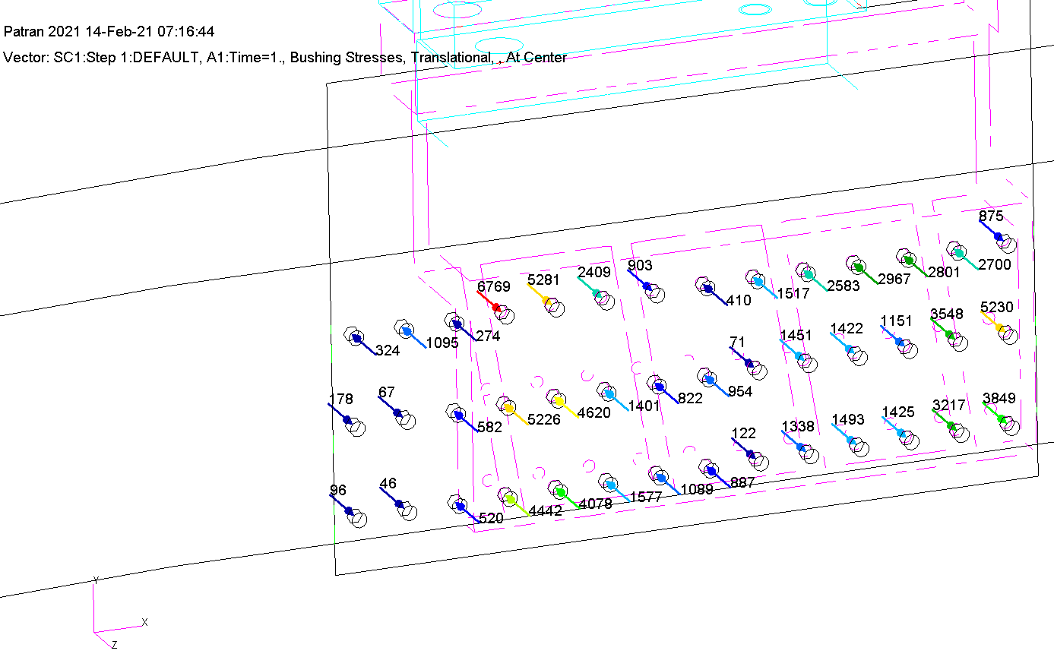
60g Longitude -X
Bolt axial force [kg]

Slide 35
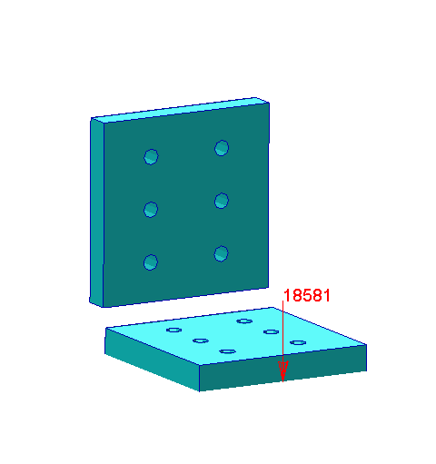
60g Longitude -X
Force Welding [Kg]
9483

Slide 36
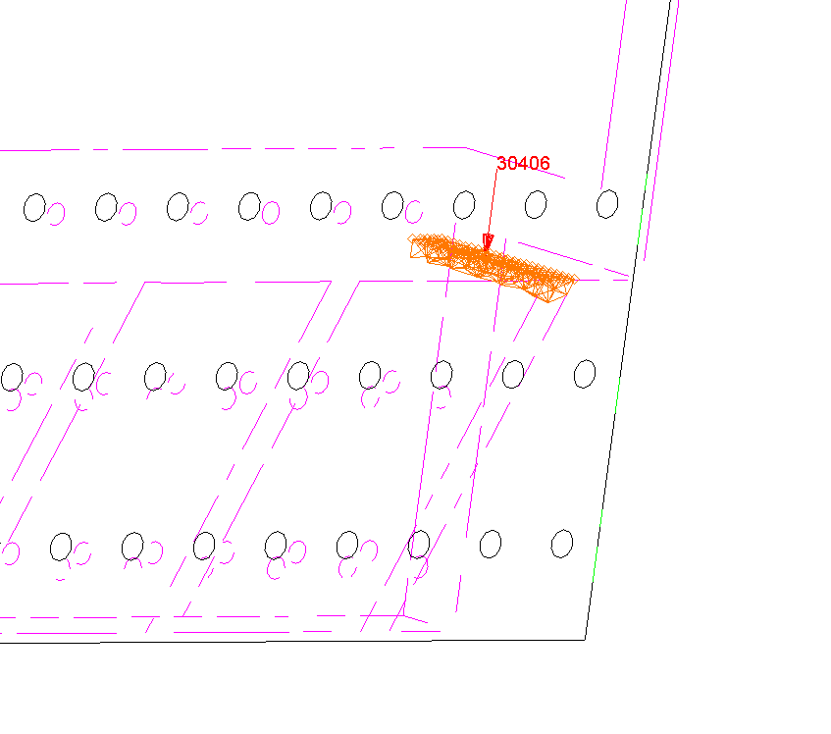
60g Longitude -X
Force Welding [Kg]

Slide 37
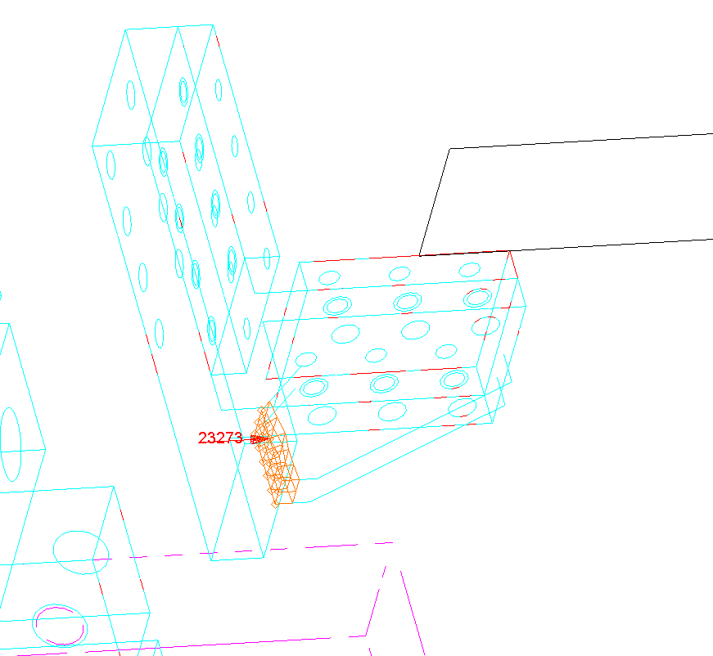
60g Longitude -X
Force Welding [Kg]

Slide 38
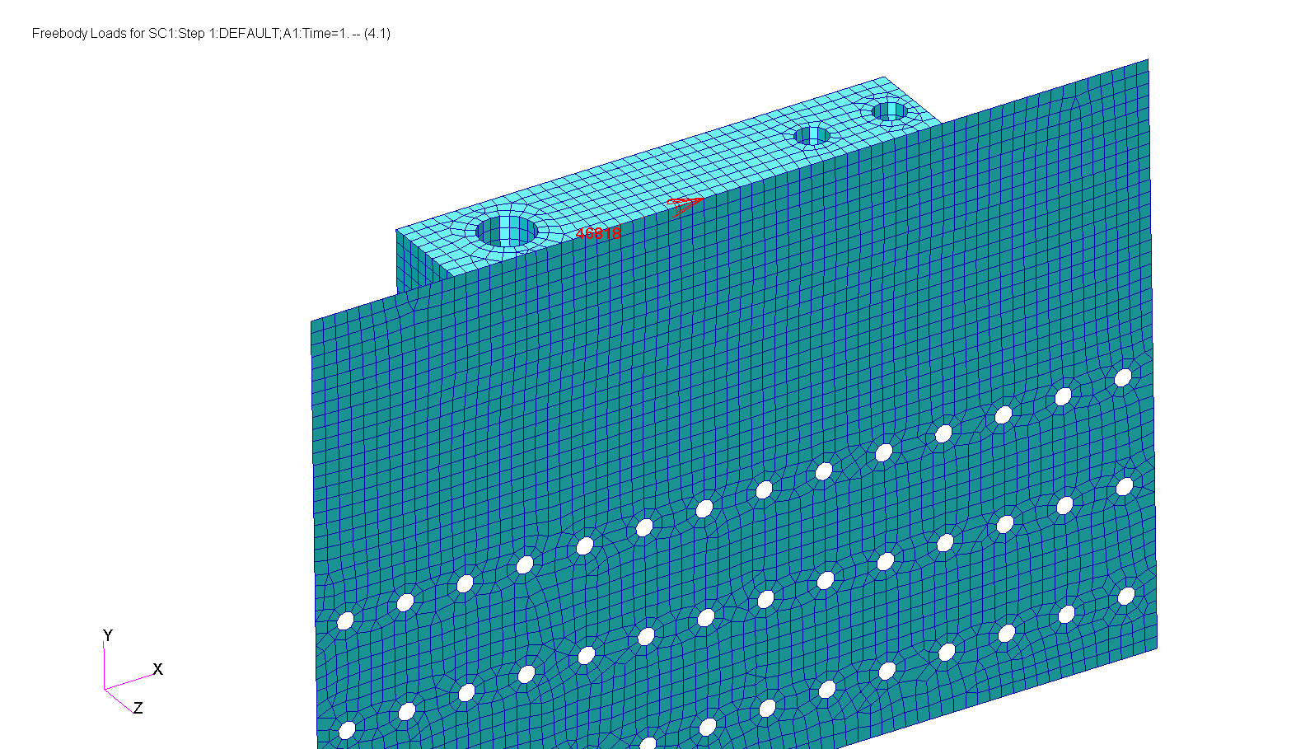
60g Longitude -X
Force Welding [Kg]

Slide 39
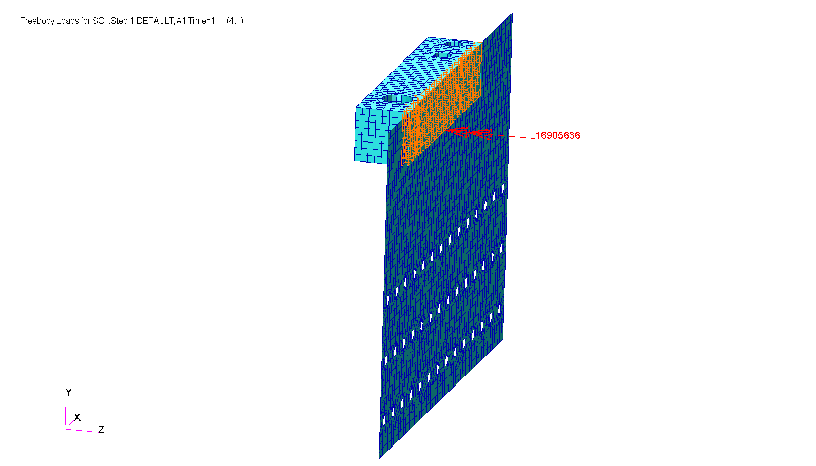
60g Longitude -X
Moment Welding [Kg*mm]

Slide 40
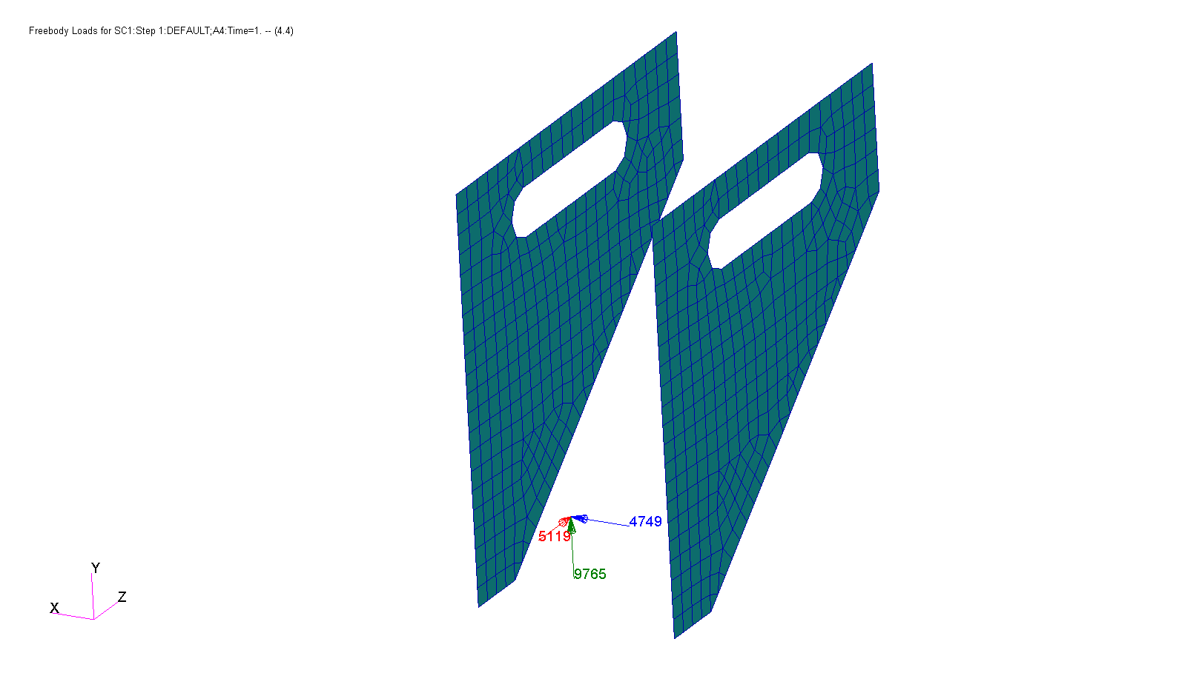
60g Longitude -X
Force Welding [Kg]

Slide 41
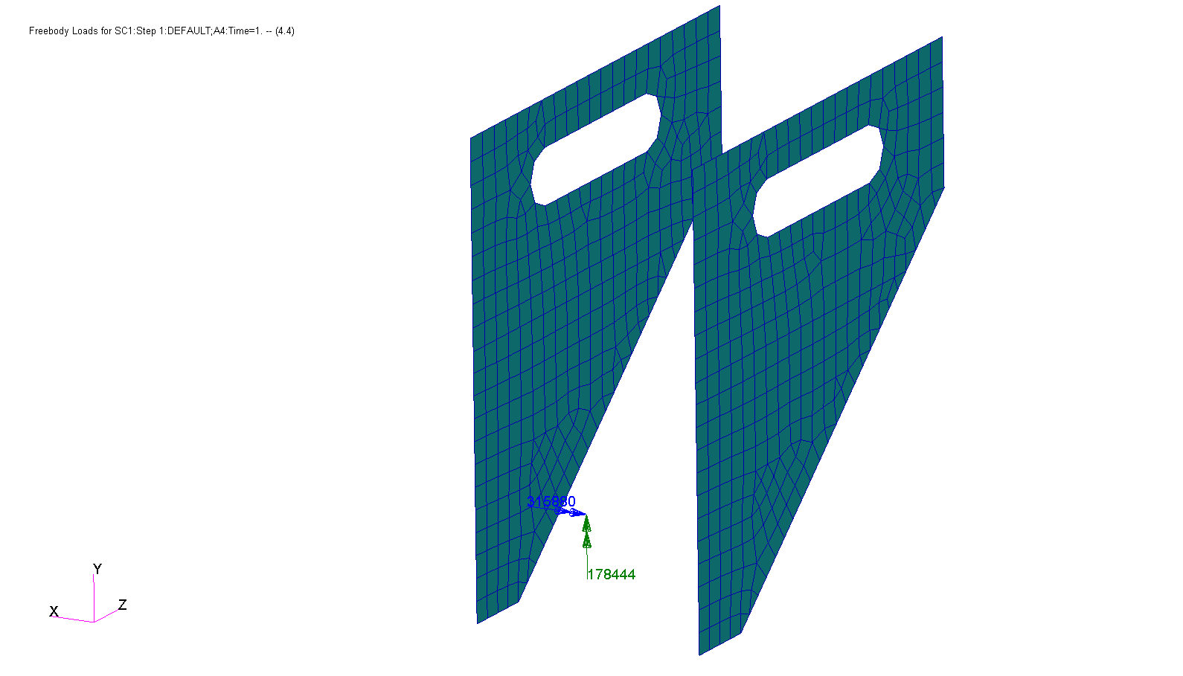
60g Longitude -X
Moment Welding [Kg*mm]

Slide 42
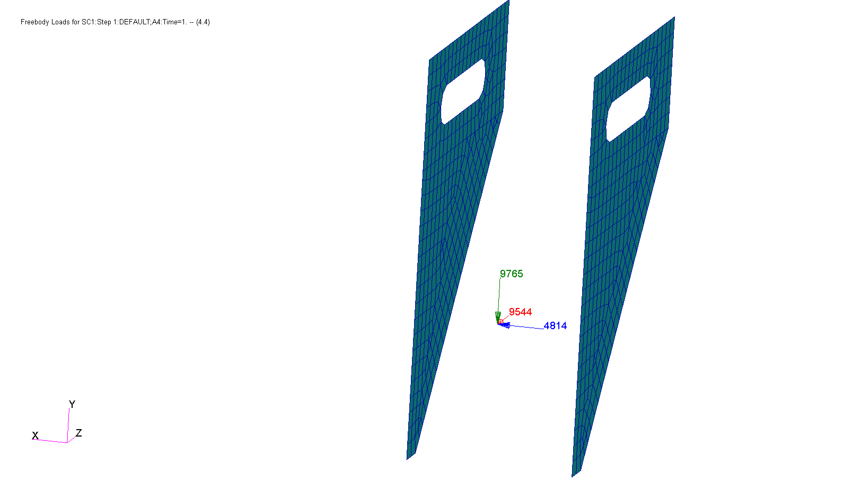
60g Longitude -X
Force Welding [Kg]

Slide 43
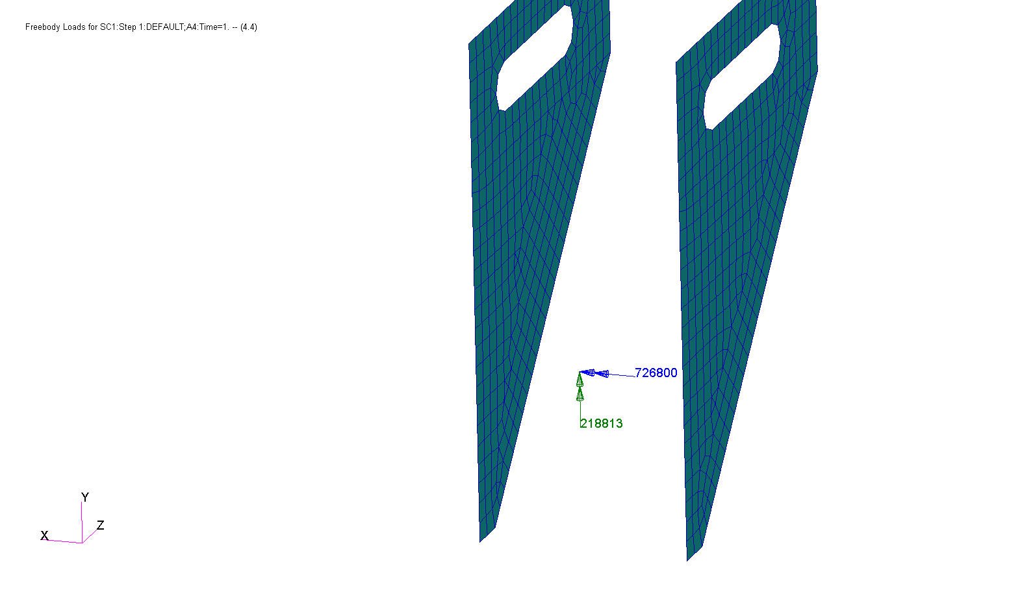
60g Longitude -X
Moment Welding [Kg*mm]

Slide 44
Stress Summary
Safety Factor | Allowable Stress $[{kg}/{{mm}^{2}}]$ | Max Stress $[{kg}/{{mm}^{2}}]$ | Material | Load case
1.71 | 120 UTS | 70.0 | Creusabro 4800 | 60g Longitude -X
1.49 | 52 UTS | 34.9 | ST52 | 60g Longitude -X
1.48 | 37 UTS | 25 | ST37 | 60g Longitude -X

Slide 45
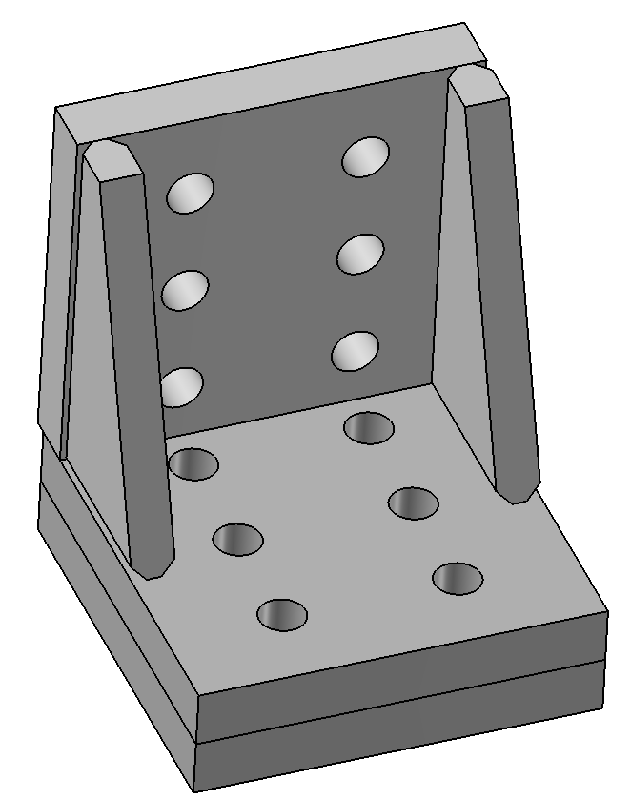
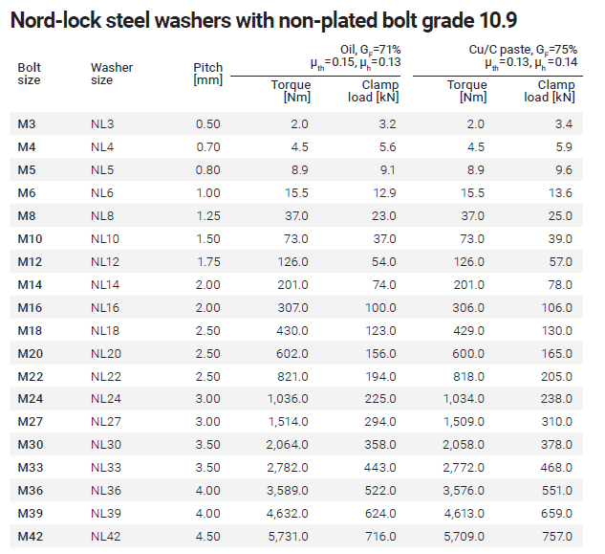
Bolts Calculation
6 Bolts M14 - Class 10.9
Tightening force 7951 Kg
Effective area – As=115 mm²
Tensile Strength 104 [kg/mm²]
Max. tension force – 2546 Kg
Total tension force – 7951+2546/4 = 8588 Kg
σ = F/As = 8588/115 = 74.7 kg/mm²
S.F = 104/74.7 = 1.4

Slide 46
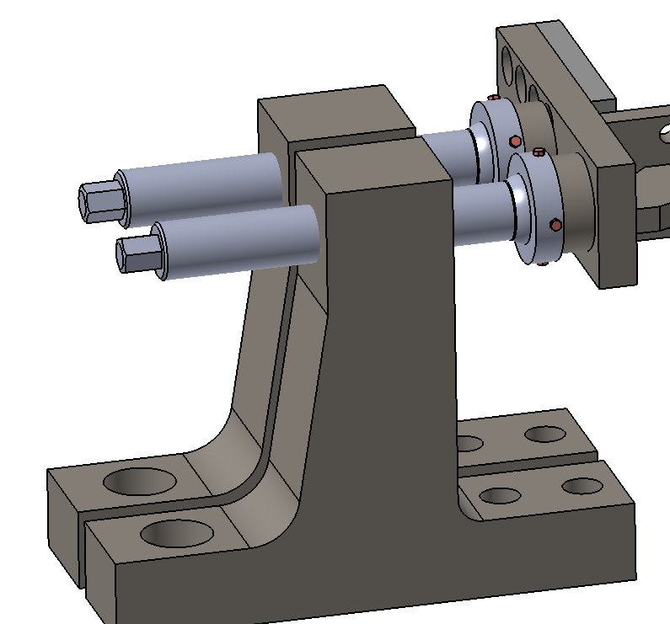
Bolts Calculation
Tensile calculation:
2 Bolts M45 – Steel 4340
Effective area – As=1256 mm²
Tensile Strength 94 [kg/mm²]
Thread calculation:
Number of threads - 3
Thread pitch 4mm
Shear area – A=1507 mm²
Tensile Strength 94 [kg/mm²]
Shear Strength 94*0.6 = 56.4 [kg/mm²]
Max. compression force – 43444 Kg
σ = F/As = 43444/1256 = 34.6 kg/mm²
Max. compression force – 43444 Kg
σ_{shear} = F/A = 43444/1507 = 28.8 kg/mm²
S.F = 94/34.6 = 2.7
S.F = 56.4/28.8 = 1.96

Slide 47
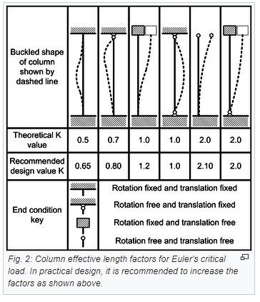
Bolt Buckling Calculation
Buckling calculation
$$P_{cr}=\frac{π^{2}∗EI}{{(KL)}^{2}}=6,997,192 kgf$$
54.6mm
E = 21000 Kg/mm²
I = 402578 mm⁴
L = 54.6 mm
K = 2
Max. compression force – 43444 Kg
S.F for Buckling = 6,997,192/43444 = 161

Slide 48
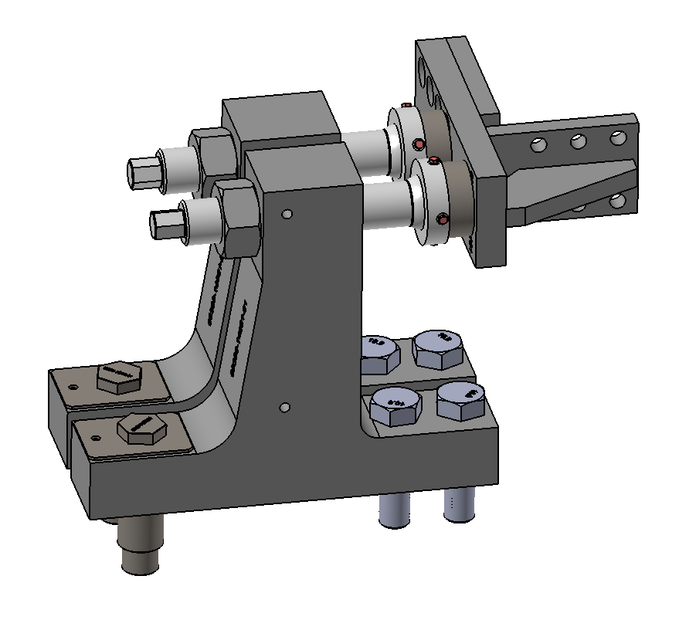
Bolts Calculation
Tensile calculation:
Thread calculation:
Number of threads - 3
Thread pitch 4mm
Shear area – A=948 mm²
Tensile Strength 104 [kg/mm²]
Shear Strength 104*0.6 = 62.4 [kg/mm²]
4 Bolts M36 - Class 10.9
Effective area – As=506 mm²
Tensile Strength 104 [kg/mm²]
Max. tension force – 36906 Kg
Max. tension force – 36906 Kg
σ_{shear} = F/A = 36906/948 = 38.9 kg/mm²
σ = F/As = 36906/506 = 72.9 kg/mm²
S.F = 104/72.9 = 1.43
S.F = 62.4/38.9 = 1.6

Slide 49
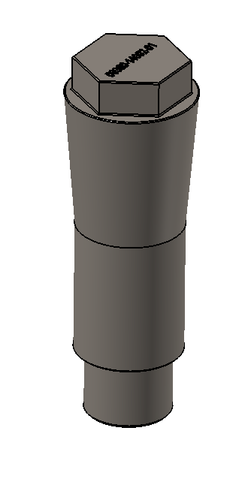
Pins Calculation
2 Pins M45 – Steel 4340
Effective area – As=1590 mm²
Tensile Strength 104 [kg/mm²]
Shear Strength 94*0.6 = 56.4 [kg/mm²]
Max. shear force – 45657 Kg
σ_{shear} = F/As = 45657/1590 = 28.7 kg/mm²
S.F = 56.4/28.7 = 1.96

Slide 50
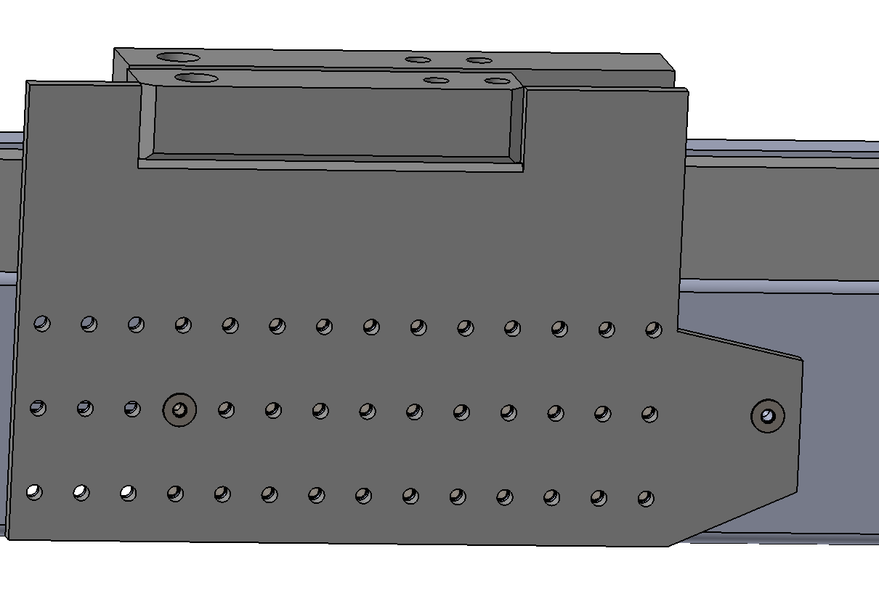
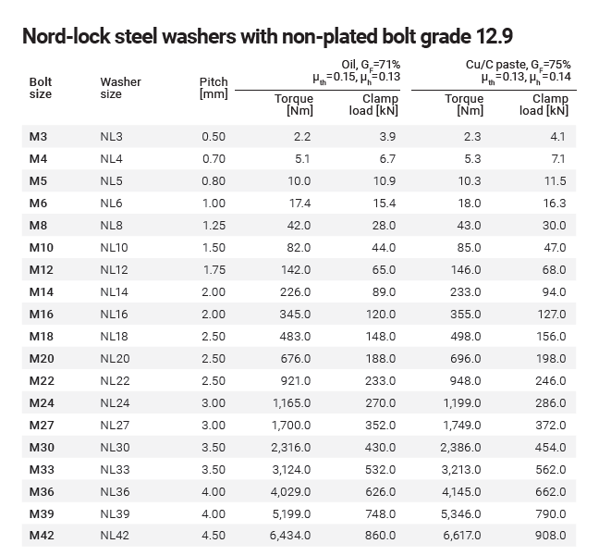
Bolts Calculation
42 Bolts M16 - Class 12.9 - Work only in tension (Shear is taken by friction and 2 pins)
Tightening force 12946 Kg
Effective area – As=157 mm²
Tensile Strength 122 [kg/mm²]
Max. tension force – 6769 Kg
Total tension force – 12946+6769/4 = 14,638 Kg
σ = F/As = 14638/157 = 93 kg/mm²
S.F = 122/93 = 1.3

Slide 51
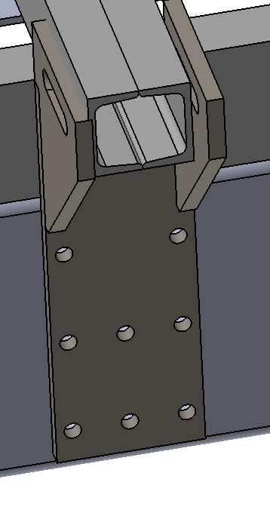
Bolts Calculation
8 Bolts M16 - Class 12.9 Work only in tension
(Shear is taken by friction)
Tightening force 12946 Kg
Effective area – As=157 mm²
Tensile Strength 122 [kg/mm²]
Max. tension force – 6618 Kg
Total tension force – 12946+6618/4 = 14600 Kg
σ = F/As = 14600/157 = 93 kg/mm²
S.F = 122/93 = 1.3

Slide 52
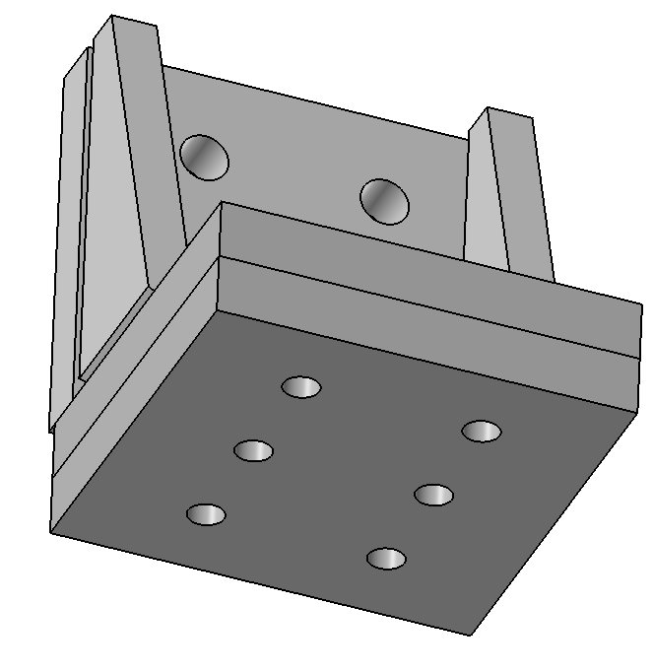
Welding Calculation
Welding Hight = 8mm
Welding Area = ((140X8))X4 = 4480 mm²
Max. tension force – 9483 Kg
Yield Strength welds 45 [kg/mm²]
σ = F/As = 9483/4480 = 2.1 kg/mm²
140mm
S.F = 45/2.1 = 21.4
140mm

Slide 53
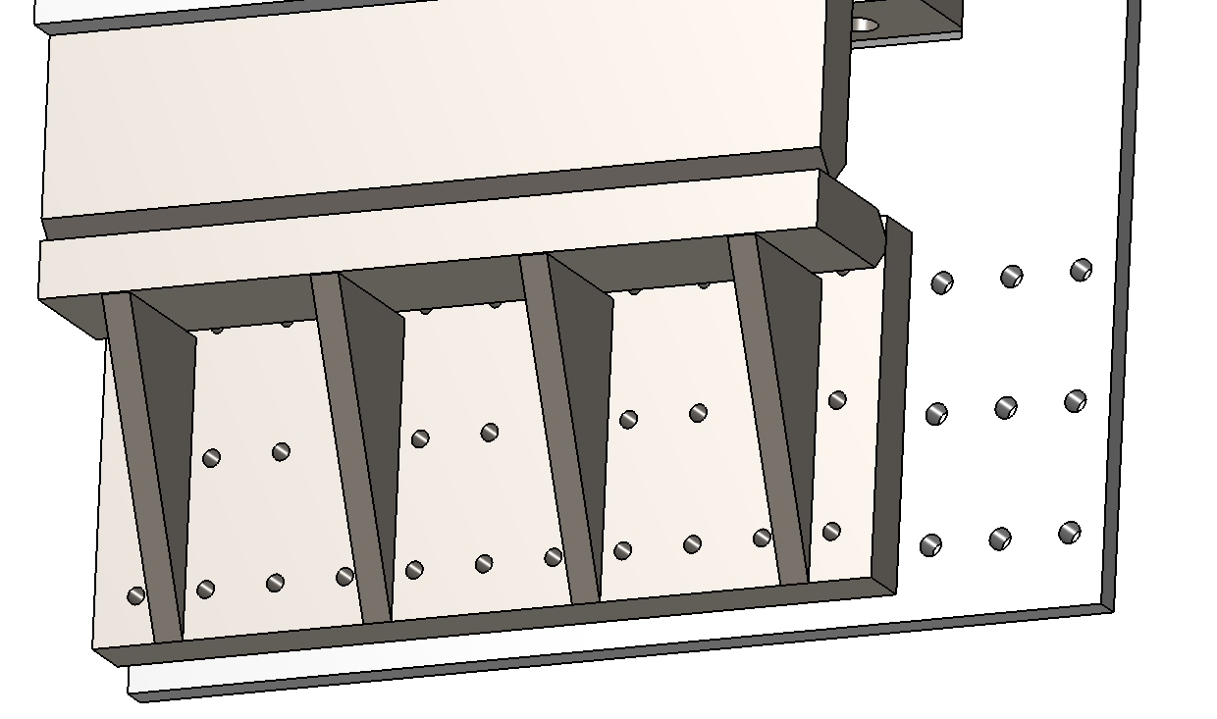
Welding Calculation
Welding Hight = 10mm
Welding Area = ((105X10))X2 = 2100 mm²
Max. tension force – 30406 Kg
Yield Strength welds 45 [kg/mm²]
105mm
σ = F/As = 30406/2100 = 14.5 kg/mm²
S.F = 45/14.5 = 3.1

Slide 54
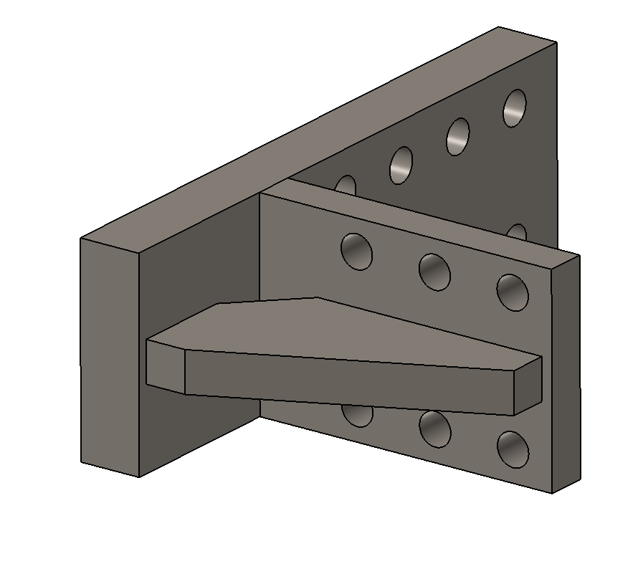
Welding Calculation
Welding Hight = 15mm
Welding Area = ((50X15))X2 = 1500 mm²
Max. tension force – 23273 Kg
Yield Strength welds 45 [kg/mm²]
σ = F/As = 23273/1500 = 15.5 kg/mm²
50mm
S.F = 45/15.5 = 2.9

Slide 55
Welding Calculation
Welding Hight = 20mm
Welding Area = (80X20X2)X2 = 6400 mm²
Max. tension force – 46818 Kgf
Yield Strength welds 45 [kg/mm²]
80mm
80mm
σ_{F} = F/As = 46818/6400 = 7.3 kg/mm²
S.F = 45/7.3 = 6.2

Slide 56
Welding Calculation
H (Welding Hight) = 20X2 = 40 [mm]
Moment X = 16905636 [kg*mm]
Yield Strength welds 45 [kg/mm²]
L = 408mm
σ_{Mx} = (6*Mx)/(H*L²) = (6*16905636)/(40*408²) = 15.2 kg/mm²
S.F = 45/15.2 = 3

Slide 57
Welding Calculation
H (Welding Hight) = 10X2 = 20mm
Welding Area = (90X20)X2 = 3600 mm²
Max. force = √(5119² + 4749²) = 6983 [Kg]
Moment X = 315880 [kg*mm]
Moment Y = 178444 [kg*mm]
Yield Strength welds 45 [kg/mm²]
σ_{F} = F_{T} /As = 6983/3600 = 1.9 kg/mm²
90mm
σ_{My} = (My)/(L*D*H) = (178444)/(90*83*20) = 1.2 kg/mm²
σ_{Mx} = (3*Mx)/(H*L²) = (3*315880)/(20*90²) = 5.9 kg/mm²
D = 83mm
σ_{combined} = √(σ_{F} ² + σ_{My} ² + σ_{Mx} ²) = 6.3 kg/mm²
S.F = 45/6.3 = 7.1

Slide 58
Welding Calculation
H (Welding Hight) = 10mm
Welding Area = (140X10)X2 = 2800 mm²
Max. force = √(9544² + 4814²) = 10689 [Kg]
Moment X = 726800 [kg*mm]
Moment Y = 218813 [kg*mm]
Yield Strength welds 45 [kg/mm²]
L = 140mm
σ_{F} = F_{T} /As = 10689/2800 = 3.8 kg/mm²
σ_{My} = (My)/(L*D*H) = (218813)/(140*83*10) = 1.9 kg/mm²
σ_{Mx} = (3*Mx)/(H*L²) = (3*726800)/(10*140²) = 11.2 kg/mm²
D = 83mm
σ_{combined} = √(σ_{F} ² + σ_{My} ² + σ_{Mx} ²) = 12 kg/mm²
S.F = 45/12 = 3.75

Slide 59
Appendix
Friction Calculation

Slide 60
M16 Bolts

Slide 61
M16 Bolts
Preload = 12946 kg
Friction force = 12946*0.4 = 5180 kg

Slide 62
1 Spring between outer plate to frame
2 Springs – 1 between each plate and frame
X friction force = Fx
Y friction force = Fy
Fx²+Fy²=5183²
X friction force = Fx
Y friction force = Fy
Fx²+Fy²=5183²

Slide 63
Bolt Force VS Displacement

Slide 64
60g Load

Slide 65
Bolt friction force [kg]
Inner Plate

Slide 66
Bolt friction force [kg]
Inner Plate

Slide 67
Bolt axial forces [kg]
Outer Plate

Slide 68
Bolt axial forces [kg]
Outer Plate

Slide 69
90g Load

Slide 70
Bolt friction force [kg]
Inner Plate
Max applied Load - 0.8*90g = 72g

Slide 71
Bolt friction force [kg]
Inner Plate
Max applied Load - 0.8*90g = 72g

Slide 72
Bolt axial forces [kg]
Outer Plate
Max applied Load - 0.8*90g = 72g

Slide 73
Bolt axial forces [kg]
Outer Plate
Max applied Load - 0.8*90g = 72g

Slide 74
Displacement magnitude [mm]
Max applied Load - 0.8*90g = 72g
Plates move together – No slip

Slide 75
M18 Bolts

Slide 76
M18 Bolts
Preload = 15600 kg
Friction force = 15600*0.4 = 6240 kg

Slide 77
1 Spring between outer plate to frame
2 Springs – 1 between each plate and frame
X friction force = Fx
Y friction force = Fy
Fx²+Fy²=6240²
X friction force = Fx
Y friction force = Fy
Fx²+Fy²=6240²

Slide 78
Bolt Force VS Displacement

Slide 79
60g Load

Slide 80
Bolt friction force [kg]
Inner Plate

Slide 81
Bolt friction force [kg]
Inner Plate

Slide 82
Bolt axial forces [kg]
Outer Plate

Slide 83
Bolt axial forces [kg]
Outer Plate

Slide 84
Displacement magnitude [mm]
Plates move together – No slip

Slide 85
90g Load

Slide 86
Bolt friction force [kg]
Inner Plate
Max applied Load - 1*90g = 90g

Slide 87
Bolt friction force [kg]
Inner Plate
Max applied Load - 1*90g = 90g

Slide 88
Bolt axial forces [kg]
Outer Plate
Max applied Load - 1*90g = 90g

Slide 89
Bolt axial forces [kg]
Outer Plate
Max applied Load - 1*90g = 90g

Slide 90
Displacement magnitude [mm]
Max applied Load - 1*90g = 90g
Plates move together – No slip

Slide 91
Pin angle [deg]
Tan(0.0278) = X/80
X = 0.039mm
There is space of 0.1mm , so there will not be any moment on the Pin.
80mm
X

