Slide 1
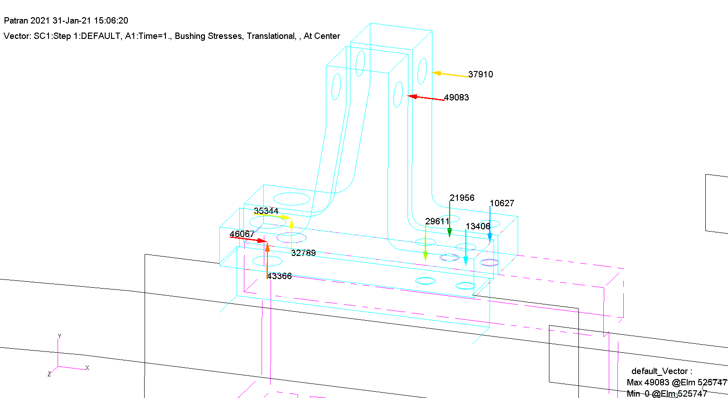
60g Longitude -X
Bolt Forces [Kgf]

Slide 2
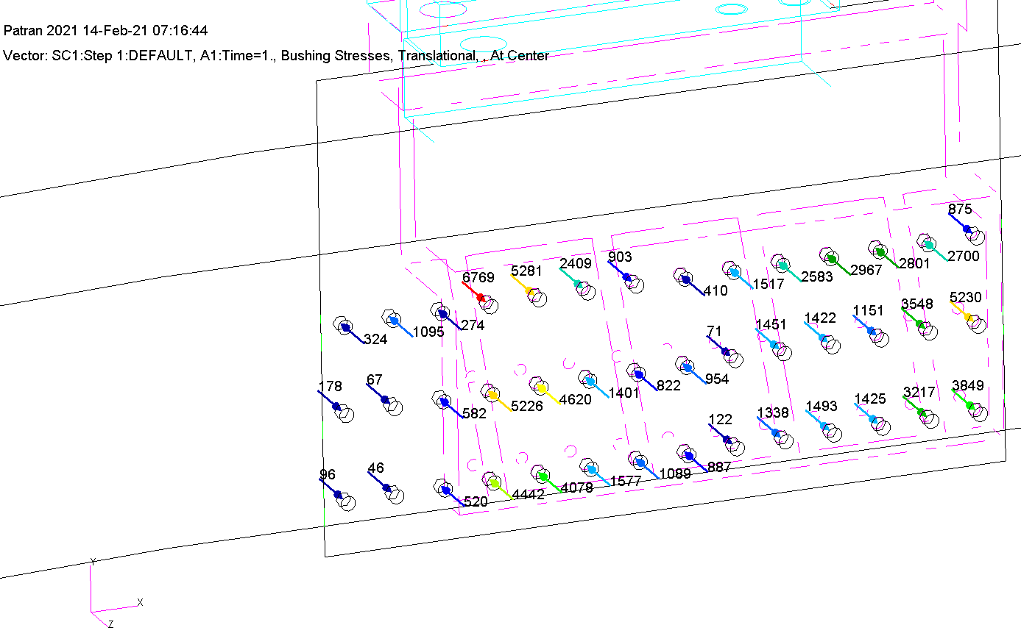
60g Longitude -X
Bolt Forces [Kgf]

Slide 3
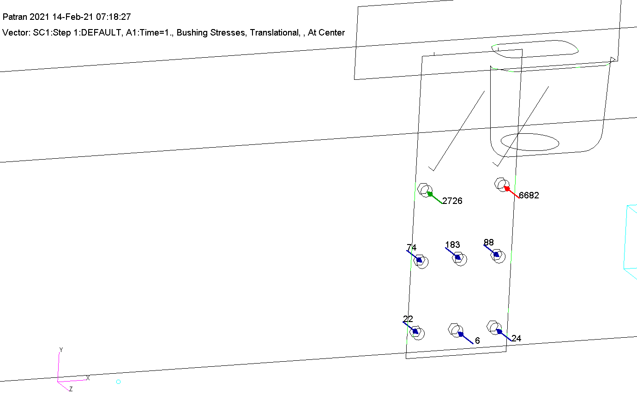
60g Longitude -X
Bolt Forces [Kgf]

Slide 4
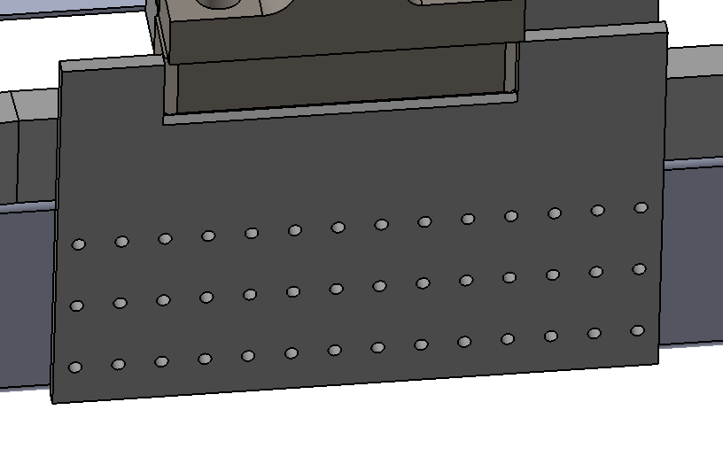
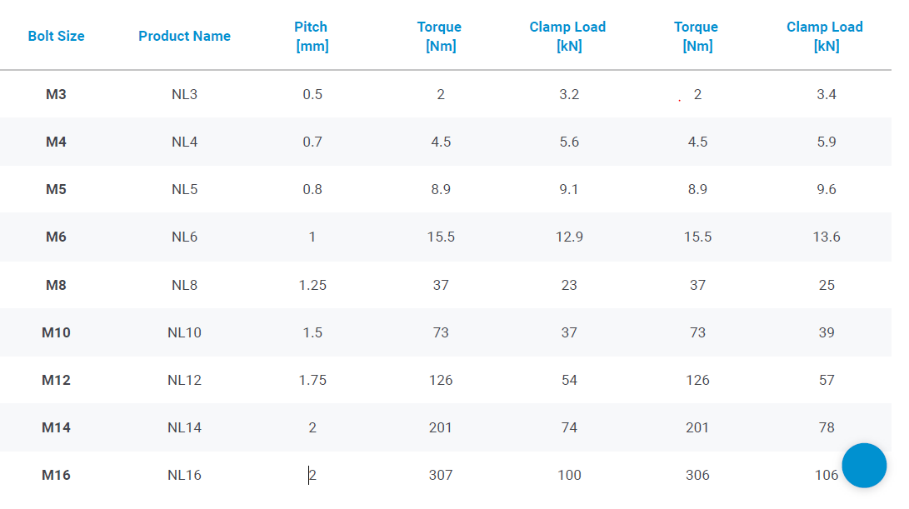
Bolts Calculation – For 12.9 Bolts
42 Bolts M14 - Class 12.9
Tightening force 9590 kgf
Effective area – As=115 mm²
Tensile stress 122 [kg/mm²]
Max. tension force – 6769 Kgf
Total tension force – 9590+6769/4 = 11282 Kgf
σ = F/As = 11282/115 = 98.1 kg/mm²
S.F = 122/98.1 = 1.24

Slide 5
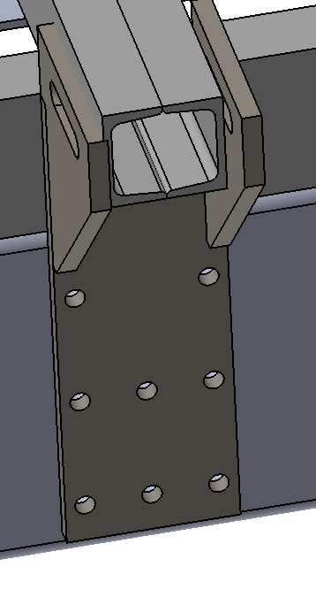
Bolts Calculation For 12.9 Bolts
42 Bolts M14 - Class 12.9
Tightening force 9590 kgf
Effective area – As=115 mm²
Tensile stress 122 [kg/mm²]
Max. tension force – 6682 Kgf
Total tension force – 9590+6682/4 = 11260 Kgf
σ = F/As = 11260/115 = 97.9 kg/mm²
S.F = 122/97.9 = 1.24

