Slide 1
Training and Certification
cloud

Slide 2
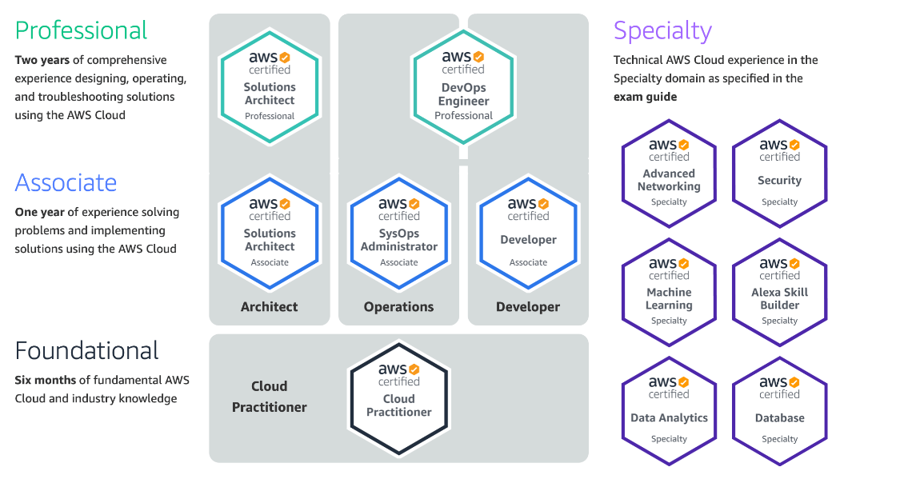
AWS Certifications

Slide 3
Google Cloud Certification
Foundational certification
Associate certification
Professional certification
Cloud Digital Leader
Associate Cloud Engineer
Professional Cloud Architect
Professional Cloud Network Engineer
Professional Cloud Security Engineer
Professional Cloud Developer
Professional Cloud DevOps Engineer
Professional Cloud Developer
Google Cloud currently offers 10 certifications

Slide 4
