Slide 1
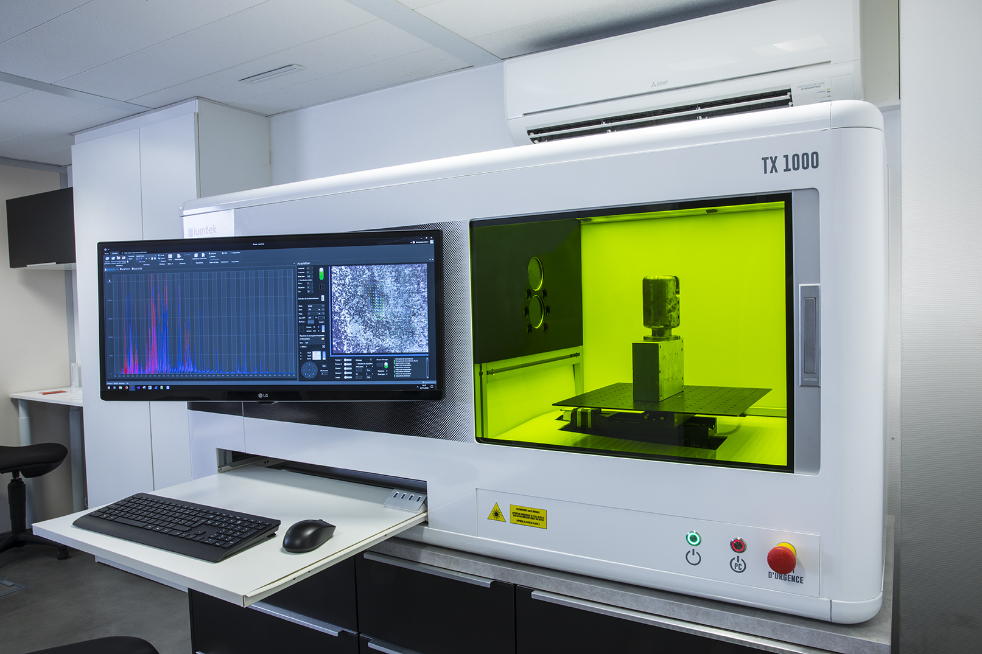
Laser Induced Breakdown Spectroscopy (LIBS)
A. Rubinstein – NRCN, IAEC
D. L’Hermite – SACLAY, CEA
Background
LIBS is an advanced tool in analytical chemistry
CEA has purchased an up-to-date TX1000 LIBS equipment from the French IUMTEK company, received in April, 2019.
IAEC received the same LIBS instrument in Israel, in Feb, 2021 (excepted the spectrometer), installed by IUMTEK in a Apr. 2022.
TX1000 LIBS equipment

Slide 2
Laser Induced Breakdown Spectroscopy (LIBS)
Overall Aim
Develop LIBS analyses on materials of interest and benchmarking according to a common CEA-IAEC program of work.
Main Objectives:
CEA: Adding of the same spectrometers in CEA’s TX1000 to have a similar IAEC’s one (2022).
IAEC: Establishing the analytical capabilities for Aluminum matrixes and building recommended wavelengths database for various impurities (2022-2023).
IAEC: Expending the analytical capabilities for other matrixes (will be discussed with CEA).

Slide 3
New – Round Robins
Overall Aim
IAEC is willing to take part in new or on-going Round Robins to establish the capabilities of different analytical techniques.

